Slide 1
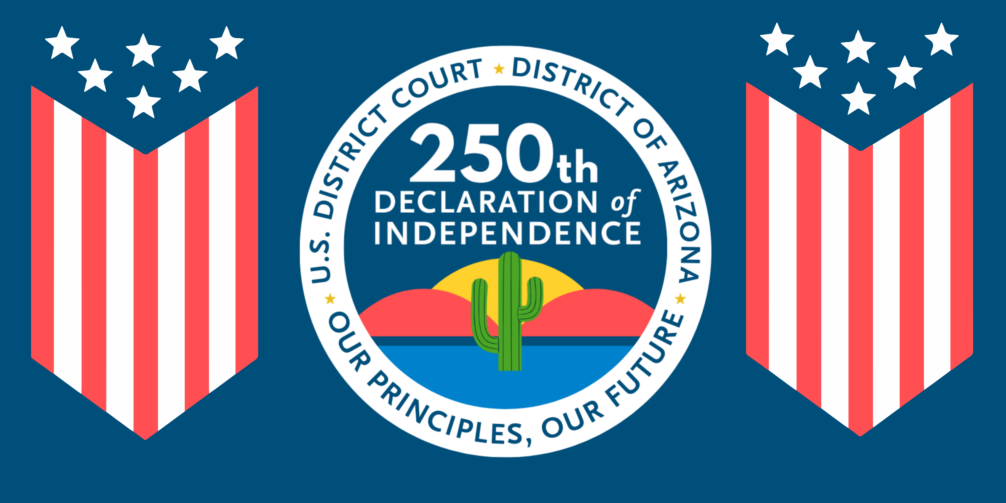

Slide 2
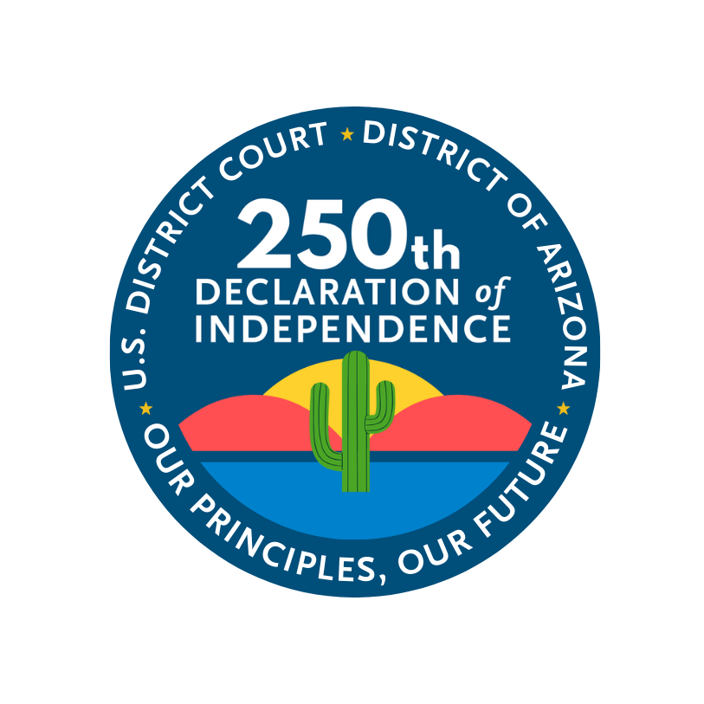
The United States District Court for the District of Arizona is proud to announce the 2026 Semiquincentennial Art and Poetry Contest.
We hope you will join us in honoring America's founding ideals through creativity and expression.

Slide 3
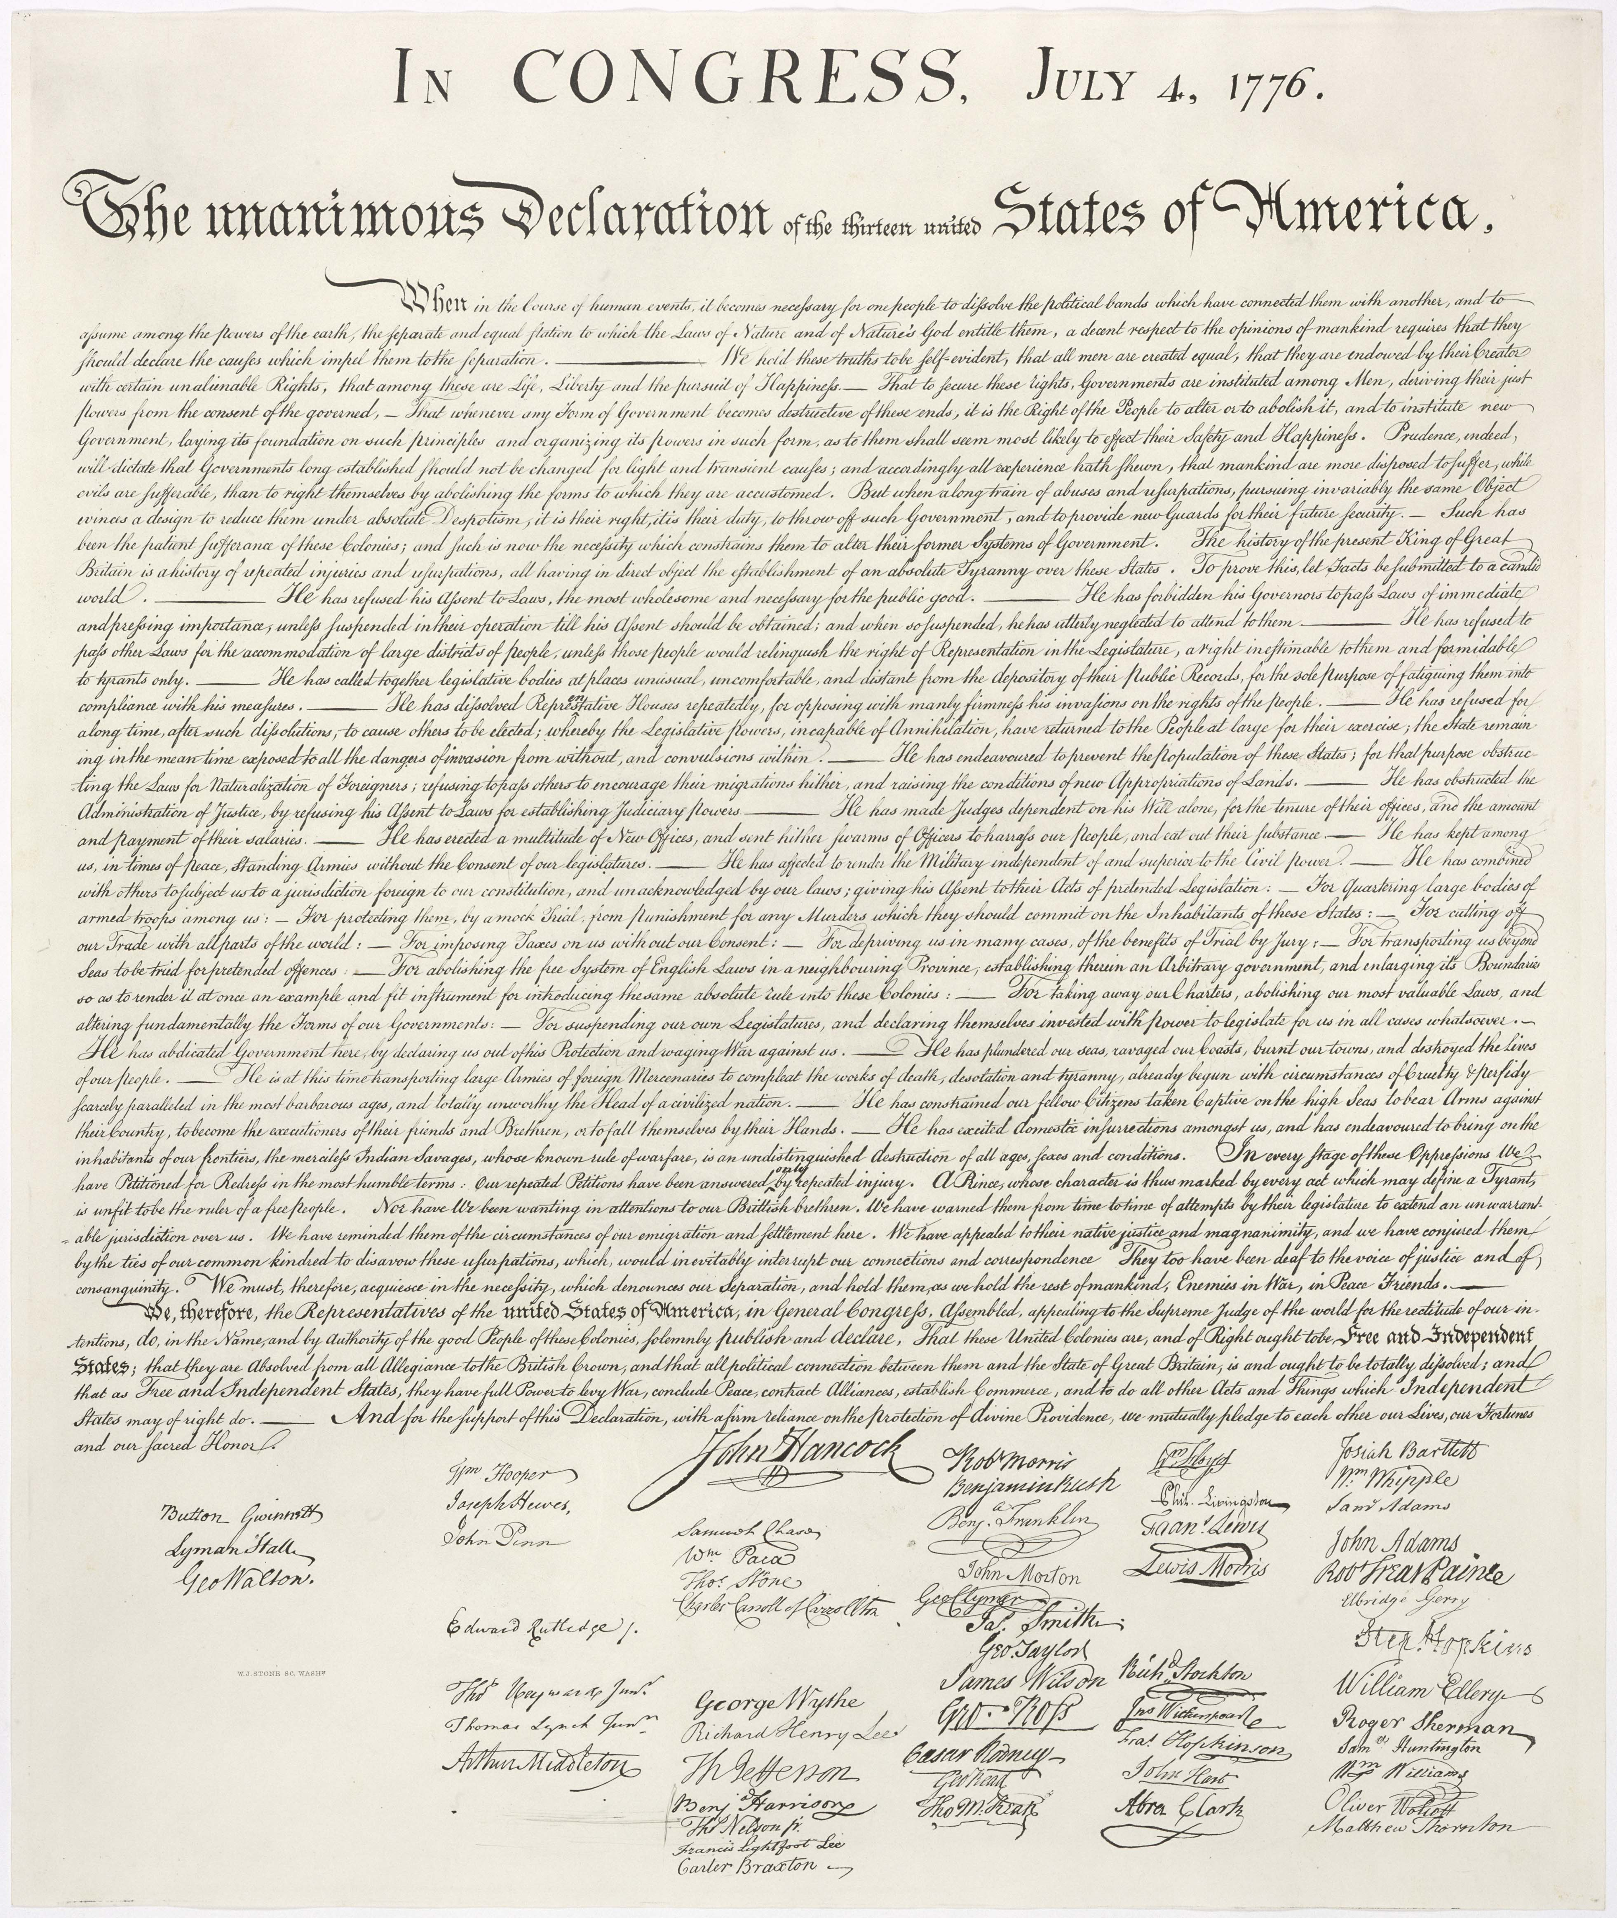
What Is the Declaration of Independence?
On July 4, 1776, leaders from the American colonies signed the Declaration of Independence to say they were no longer ruled by Great Britain. This act created a new country—the United States of America.
The signing of the Declaration of Independence marked the moment when the American colonies formally chose freedom and self-government and announced that decision to the world.
Notes:
Read the slide aloud. Use simple explanations and ask students what they notice. Encourage discussion about feelings, symbols, and ideas connected to freedom.

Slide 4
What Is the Declaration of Independence?
The Declaration stated that all people are born with important rights, including:
  Life
  Liberty
  The pursuit of happiness
These ideas were powerful and new at the time and helped shape American values.
Notes:
Read the slide aloud. Use simple explanations and ask students what they notice. Encourage discussion about feelings, symbols, and ideas connected to freedom.

Slide 5
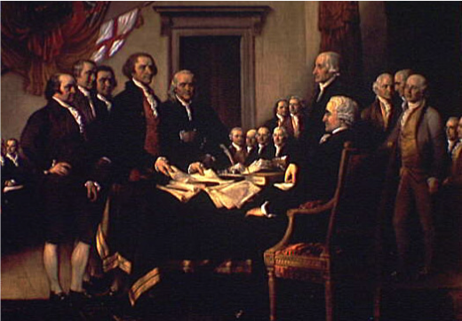
Why Celebrate 250 Years?
We are both the world's oldest democracy and a still-evolving experiment in self-government.
Just 45 people have served as president of the United States of America, from our first president, George Washington to our current president, Donald Trump.
Even 250 years later, the Declaration of Independence reminds Americans to:
  Stand up for fairness
  Protect freedom
  Work toward equality
  Care for one another
Its message continues to inspire laws, leaders, artists, and students.
Notes:
Read the slide aloud. Use simple explanations and ask students what they notice. Encourage discussion about feelings, symbols, and ideas connected to freedom.

Slide 6
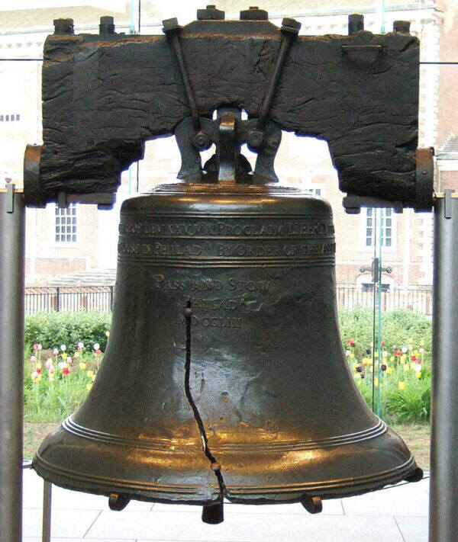
The Liberty Bell
The Liberty Bell represents freedom and independence. It reminds Americans of the country’s fight to be free from British rule and the idea that people should be free to make their own choices.
The Liberty Bell is famous for its crack. Even though it can no longer ring, the crack reminds us that:
  Freedom can be fragile
  The journey toward equality is not perfect
  Even something broken can still have meaning
Notes:
Read the slide aloud. Use simple explanations and ask students what they notice. Encourage discussion about feelings, symbols, and ideas connected to freedom.

Slide 7
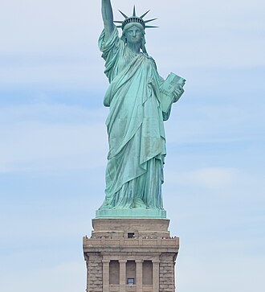
The Statue of Liberty
The Statue of Liberty represents freedom and independence. She reminds people of the ideas in the Declaration of Independence—that everyone deserves liberty and basic rights.
The statue was a gift from France to the United States in 1886. It celebrates the friendship between the two countries and their shared belief in freedom and democracy.
Notes:
Read the slide aloud. Use simple explanations and ask students what they notice. Encourage discussion about feelings, symbols, and ideas connected to freedom.

Slide 8
The Statue of Liberty
Standing in New York Harbor, the Statue of Liberty was often the first thing immigrants saw when they arrived in America. To many families, she became a symbol of:
  Hope
  New beginnings
  Opportunity
Every part of the statue has meaning:
  Torch – Lights the way to freedom
  Broken chains at her feet – Freedom from oppression
  Tablet – Law and justice, showing the date July 4, 1776
Notes:
Read the slide aloud. Use simple explanations and ask students what they notice. Encourage discussion about feelings, symbols, and ideas connected to freedom.

Slide 9
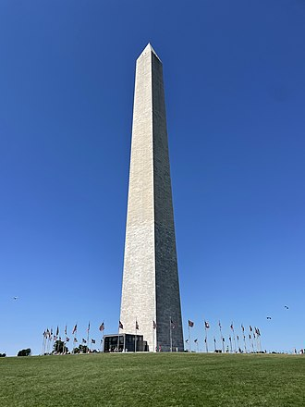
The Washington Monument
The Washington Monument was built to honor George Washington, the first President of the United States. He helped lead the American colonies to independence and is often called the “Father of Our Country.”
The tall, strong shape of the monument represents strong leadership and responsibility. It reminds us that good leaders should be honest, brave, and willing to serve others.
Notes:
Read the slide aloud. Use simple explanations and ask students what they notice. Encourage discussion about feelings, symbols, and ideas connected to freedom.

Slide 10
The Washington Monument
The monument stands in the nation’s capital, Washington, D.C., where people from all over the country come together. It shows that the states are united as one nation.
Because the monument is one of the tallest structures in the city, it symbolizes:
  Strength
  Endurance
  The lasting ideas of freedom and democracy
Notes:
Read the slide aloud. Use simple explanations and ask students what they notice. Encourage discussion about feelings, symbols, and ideas connected to freedom.

Slide 11
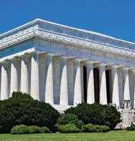
The Lincoln Memorial
The Lincoln Memorial was built to honor Abraham Lincoln, the 16th President of the United States. He led the country during the Civil War and worked to keep the nation together.
President Lincoln believed that all people should be free. He helped end slavery by supporting the Emancipation Proclamation, which freed many enslaved people.
The memorial reminds us that freedom should belong to everyone.
Notes:
Read the slide aloud. Use simple explanations and ask students what they notice. Encourage discussion about feelings, symbols, and ideas connected to freedom.

Slide 12
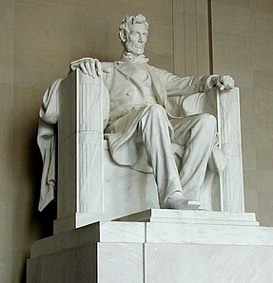
The Lincoln Memorial
The Lincoln Memorial stands in Washington, D.C., as a reminder that even during difficult times, Americans must work together. It represents the idea that the country is strongest when it is united.
The Lincoln Memorial reminds us to:
  Treat others with fairness and respect
  Work toward equality
  Stand together even during challenging times
Notes:
Read the slide aloud. Use simple explanations and ask students what they notice. Encourage discussion about feelings, symbols, and ideas connected to freedom.

Slide 13
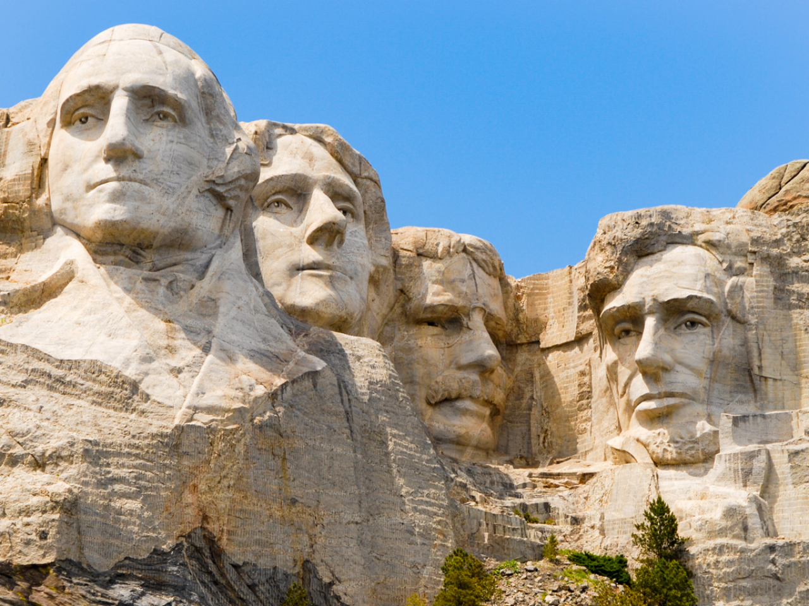
Mount Rushmore
Mount Rushmore features the faces of George Washington, Thomas Jefferson, Theodore Roosevelt, and Abraham Lincoln. Each president played an important role in shaping the United States:
George Washington – Led the nation during its founding and served as the first president.
Thomas Jefferson – Was the primary author of the Declaration of Independence.
Theodore Roosevelt – Oversaw major national growth and created national parks and protected lands.
Abraham Lincoln – Led efforts to preserve the Union and move toward ending slavery.
Notes:
Read the slide aloud. Use simple explanations and ask students what they notice. Encourage discussion about feelings, symbols, and ideas connected to freedom.

Slide 14
Mount Rushmore
The monument represents democracy, which means people have a voice in how they are governed. The presidents shown helped protect and strengthen this idea.
Mount Rushmore reminds us that:
Leaders shape the nation’s future
Democracy takes effort and responsibility
History helps us understand who we are
Notes:
Read the slide aloud. Use simple explanations and ask students what they notice. Encourage discussion about feelings, symbols, and ideas connected to freedom.

Slide 15
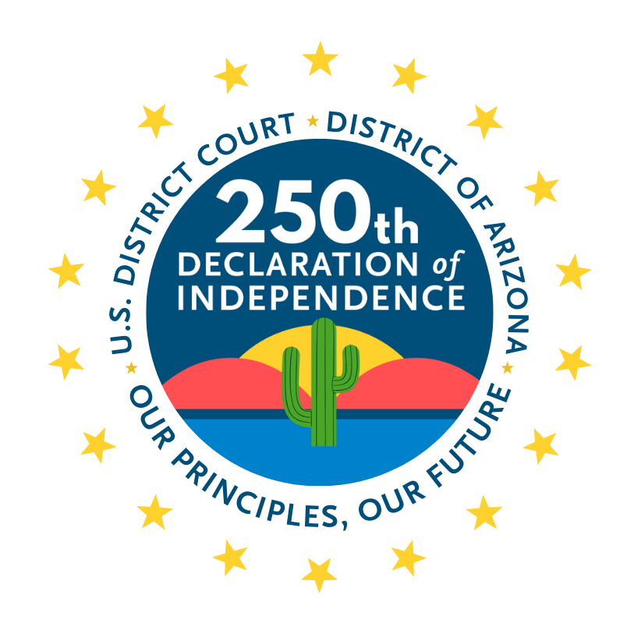
Prompts to Spark Your Creativity
The prompts in the following slides are here to help you start thinking, imagining, and exploring. You can use a prompt if it inspires you — or follow your own idea and create something completely original!
Notes:
Explain expectations clearly. Emphasize creativity, effort, and personal meaning. There are no wrong answers in art.

Slide 16
Art and Poetry Prompt 1: Symbols of Freedom
Create a symbol that shows freedom
Use a monument or create your own idea
Use colors, shapes and descriptions to show meaning
Notes:
Explain expectations clearly. Emphasize creativity, effort, and personal meaning. There are no wrong answers in art.

Slide 17
Art and Poetry Prompt 2:
Life, Liberty, and the Pursuit of Happiness
What does the pursuit of happiness mean to you?
1
What obstacles come with pursuing life, liberty, or happiness?
2
Show or tell why Life, Liberty, and the Pursuit of Happiness is important.
Notes:
Explain expectations clearly. Emphasize creativity, effort, and personal meaning. There are no wrong answers in art.

Slide 18
Art and Poetry Prompt 3: New Frontiers
Resilience
The Declaration of Independence serves as a crucial document of American resilience, embodying the courage of the original colonists to overcome British rule.
Innovation/ Creativity
The United States is one of the most technologically advanced nations in the world. American innovation has advanced through technological and industrial advancements such as the airplane, telephone, and assembly line.
Progress
The Founding Fathers intended the Declaration of Independence to be flexible in order to fit the nation’s progress and circumstances of the country.
Notes:
Explain expectations clearly. Emphasize creativity, effort, and personal meaning. There are no wrong answers in art.

Slide 19
Art and Poetry Prompt 4:
America – Past, Present, or Future
Show
Show America long ago, today, or in the future
Think about
Think about life in America 250 years in the past, now, or 250 years in the future
Share
Share your dreams for America
Notes:
Explain expectations clearly. Emphasize creativity, effort, and personal meaning. There are no wrong answers in art.

Slide 20
Art and Poetry Prompt 5: My Place in America’s Story
Community
Community is not just a place or location but also the sharing of common values or ideas.
How has community helped develop the United States of America?
Unity
Unity is cultivated by embracing both the country's ideals and its ongoing work to improve.
How has unity through respect and inclusiveness promote a “single unit” despite differences?
Diversity
While demographic, cultural, and political differences exist, common principles like liberty, equality, and the ability to participate in civic life remain certain.
How has diversity helped shape the United States of America?
Notes:
Explain expectations clearly. Emphasize creativity, effort, and personal meaning. There are no wrong answers in art.

