Slide 1
The National Court Interpreter Database: A Key to Success

Slide 2
The National Court Interpreter Database: A Key to Success
CJA Activating Privileges
CJA related work:
exempt from PACER fees.
-Existing CJA attorney with a PACER exempt account in a NextGen court
-Newly appointment CJA attorney with an existing PACER account
CJA Toggle Feature
-Newly appointed CJA attorney with no PACER account
CJA Exempt
CJA Non -Exempt
Notes:
On February 7, 2022, the District of Arizona will upgrade to NextGen CM/ECF. CJA related work is exempt from PACER fees for attorneys under CJA. NextGen CM/ECF provides a toggle feature for CJA Attorneys to switch from non-exempt to exempt status when performing CJA related work.
CJA attorneys must first activate CJA privileges if they are an existing CJA attorney with a PACER exempt account in a NextGen court; a newly appointment CJA attorney with an existing PACER account; or a newly appointed CJA attorney with no PACER account.

Slide 3
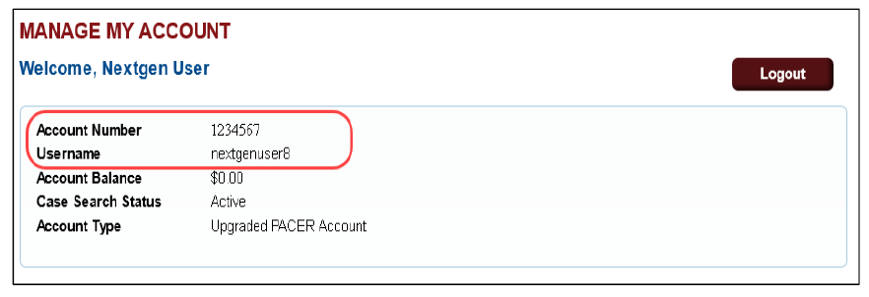
Existing CJA Attorney with a PACER-Exempt Account
The National Court Interpreter Database: A Key to Success
Contact the PACER Service Center (PSC) at (800) 676-6856 or email them at
pacer@psc.uscourts.gov
The PSC will send you an email with instructions on how to proceed
Notes:
Existing CJA attorneys must contact the PACER Service Center to request CJA privileges be added to their upgraded PACER account.
The attorney must provide their name, username, and the account number of their upgraded PACER account. This information can be found by logging into “Manage My Account” at www.pacer.gov. The attorney will need to provide the district in which they have been appointed as a CJA attorney.
The PACER Service Center will send the attorney an email with instructions on how to proceed.

Slide 4
Newly Appointed CJA Attorney with an Existing PACER Account
The National Court Interpreter Database: A Key to Success
Contact the PACER Service Center (PSC) at (800) 676-6856 or email them at
pacer@psc.uscourts.gov
→PSC will send an email
**Change PACER Exemption Status toggle
→ Reply to the email
→ CJA privileges will not be activated until the attorney acknowledges the terms of use.
Notes:
Newly appointed CJA attorneys with an existing PACER account must contact the PACER Service Center to request CJA privileges be added to their upgraded PACER account.
The attorney must provide their name, username, and the account number of their upgraded PACER account. This information can be found by logging into “Manage My Account” at www.pacer.gov. The attorney will need to provide the district in which they have been appointed as a CJA attorney.
The PACER Service Center will send the attorney an email with the CJA acknowledgement and instructions for exempt usage. The attorney must reply acknowledging the acceptance and understanding of the terms of use. CJA privileges will not be activated until the attorney acknowledges the terms of use.
Upon receipt of acknowledgment, CJA privileges will be activated, and the Change PACER Exemption Status toggle in NextGen courts will be available.

Slide 5
Newly Appointed CJA Attorney with NO PACER Account
The National Court Interpreter Database: A Key to Success
Register for a PACER account at www.pacer.gov
→PSC will send an email
**Change PACER Exemption Status toggle
→ Reply to the email
→ CJA privileges will not be activated until the attorney acknowledges the terms of use.
Notes:
Newly appointed CJA attorneys with no PACER account must register for a PACER account at www.PACER.gov.
Complete all required fields on the registration. Select the check box indicating the account will be used by an attorney appointed to the CJA Attorney Panel in the Account Information section. After you select the check box, the attorney must select the jurisdiction where they have been appointed as a CJA attorney.
The PACER Service Center will send the attorney an email with the CJA acknowledgement and instructions for exempt usage. The attorney must reply acknowledging the acceptance and understanding of the terms of use. CJA privileges will not be activated until the attorney acknowledges the terms of use.
Upon receipt of acknowledgment, CJA privileges will be activated, and the Change PACER Exemption Status toggle in NextGen courts will be available.

Slide 6
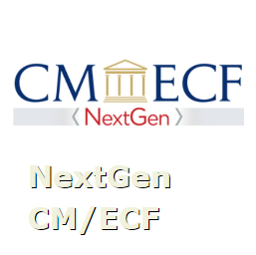
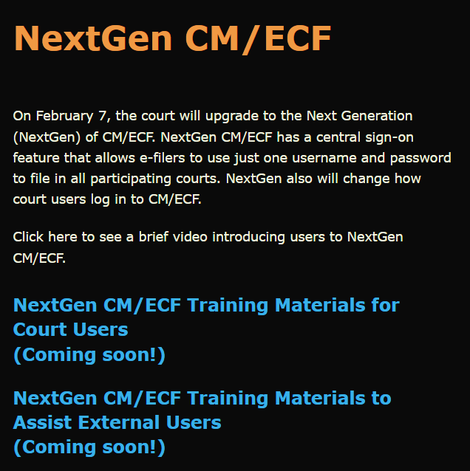
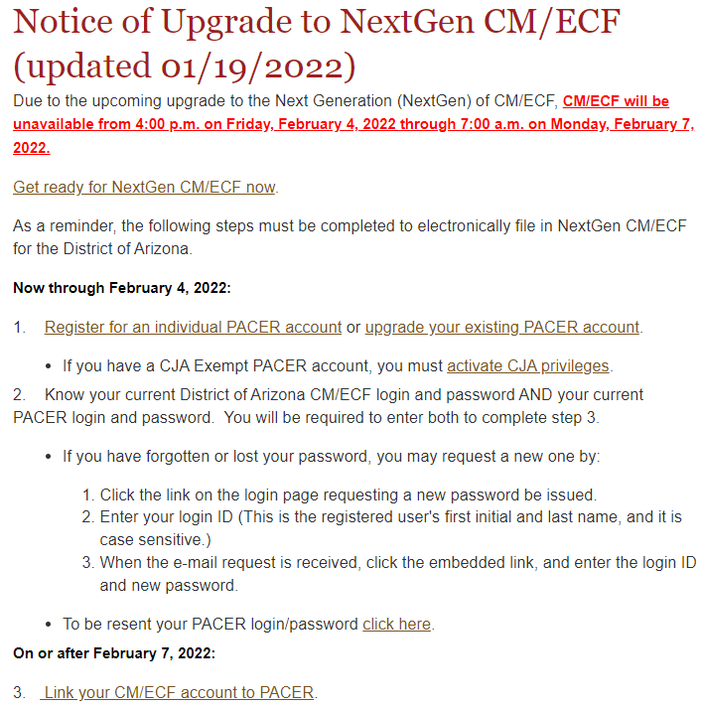
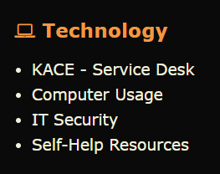
Resources
The National Court Interpreter Database: A Key to Success
District Arizona Intranet Page
District of Arizona internet page: https://www.azd.uscourts.gov
Notes:
This video and other NextGen Resources can be found on the court’s intranet page.
Submit a KACE – Service Desk request for help with NextGen CM/ECF.
Direct the public to the court’s internet page to access NextGen CM/ECF information.

