Slide 1



The National Court
Interpreter Database: A Key to Success

Slide 2

CJA Exempt Status Toggle Feature
The National Court
Interpreter Database: A Key to Success
CJA Exempt
CJA Non -Exempt
CJA attorneys
CJA privileges
Upgraded PACER Account
Notes:
On February 7, 2022, the District of Arizona will upgrade to NextGen CM/ECF. NextGen CM/ECF provides a new toggle feature that allows CJA attorneys to switch from non-exempt to exempt status when performing CJA-related work, which is exempt from PACER fees. This feature is available to attorneys that have been appointed as a CJA attorney. To activate this feature, a CJA attorney must activate CJA privileges on their upgraded PACER account.

Slide 3
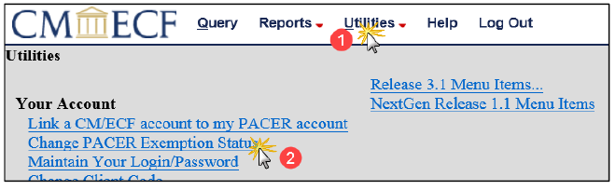
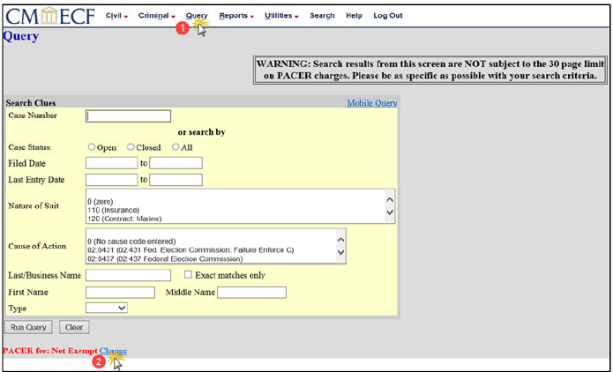
NextGen Courts and the Change PACER Exemption Status Toggle.
The National Court
Interpreter Database: A Key to Success
Log on using your upgraded PACER account.
Two processes to change PACER Exemption Status
Notes:
There are two processes available to change the CJA Exempt Status.
Click Utilities, then change PACER Exemption Status link.
OR
Click Query, and then Change link. The PACER fee status is located under the Run Query button.

Slide 4
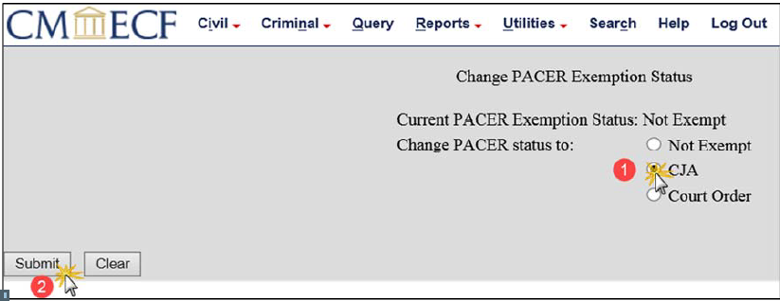
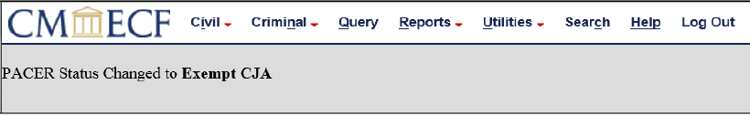
Change PACER Exemption Status
The National Court
Interpreter Database: A Key to Success
Notes:
On the Change PACER Exemption Status screen, click CJA radio button. Click Submit. A confirmation screen will display.

Slide 5
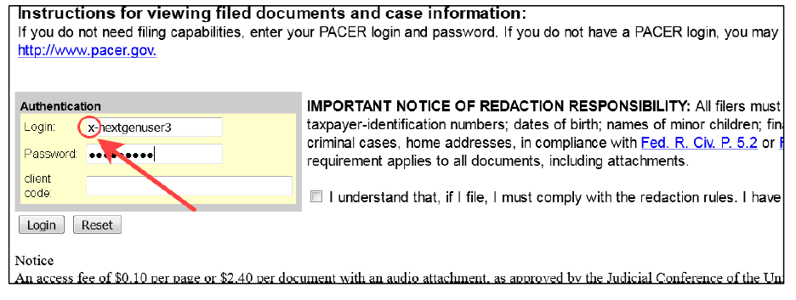
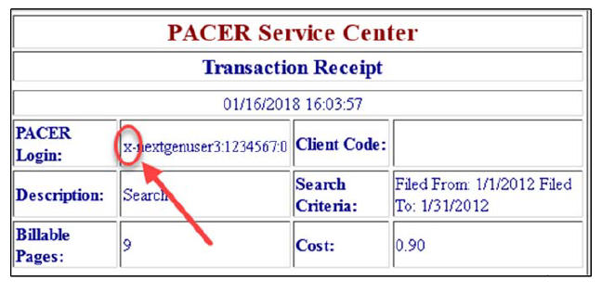
CurrentGen Courts and “x-” Prefix
The National Court
Interpreter Database: A Key to Success
Separate exempt and non exempt PACER accounts are no longer issued.
If accessing a CurrentGen court, add “x-” prefix to PACER user name.
Notes:
As of August 2014, all newly appointed CJA attorneys are no longer issued separate exempt PACER accounts to be used only when performing CJA-related work. CJA attorneys can now log on using an “x-” prefix with their upgraded PACER user name and password to perform CJA-related work and not incur PACER fees when accessing CurrentGen courts.
The CJA attorney may verify their exempt status by reviewing the receipt.

Slide 6
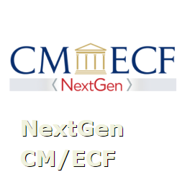
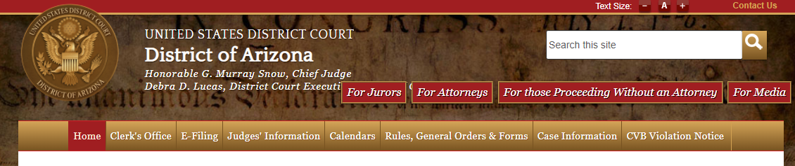
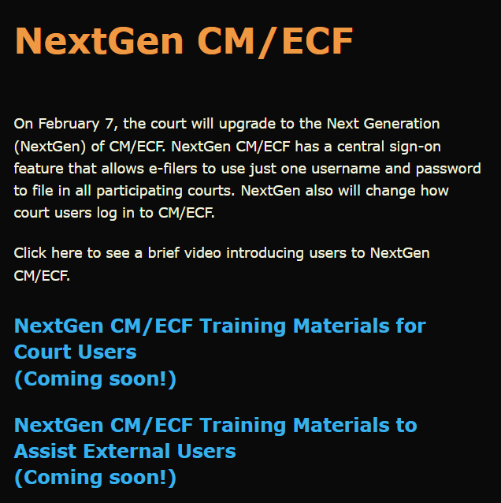
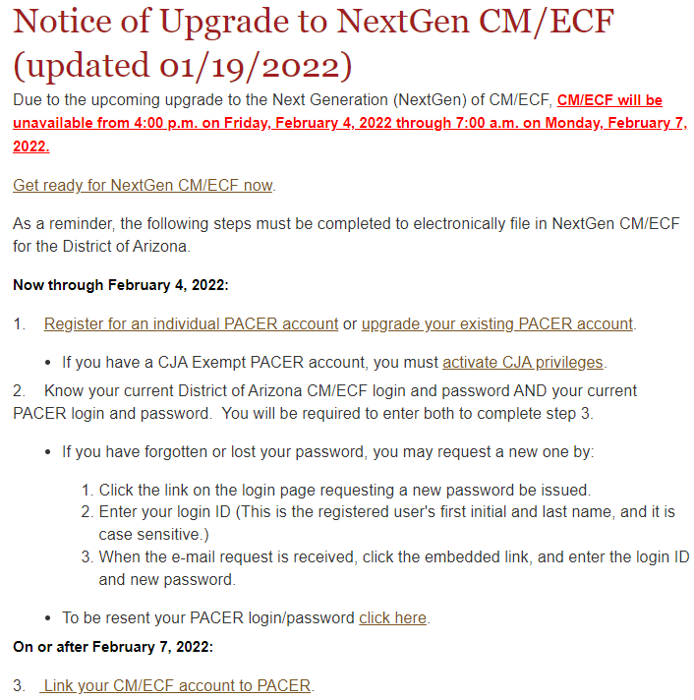
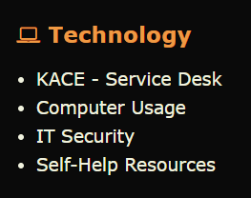
Resources
The National Court
Interpreter Database: A Key to Success
District Arizona Intranet Page
District of Arizona internet page: https://www.azd.uscourts.gov
Notes:
This video and other NextGen Resources can be found on the court’s intranet page.
Submit a KACE – Service Desk request for help with NextGen CM/ECF.
Direct the public to the court’s internet page to access NextGen CM/ECF information.

