Slide 1
The National Court Interpreter Database: A Key to Success

Slide 2
CJA Navigating from Legacy to
NextGen Court
The National Court Interpreter Database: A Key to Success
NextGen Court as a CJA appointed attorney
Log out
Log in with “x-” prefix
CurrentGen Court as a CJA appointed attorney
Notes:
On February 7, 2022, the District of Arizona will upgrade to NextGen CM/ECF. CJA attorneys may accept CJA appointments in both NextGen and Legacy (CurrentGen) CM/ECF courts. CJA related work is exempt from PACER fees and understanding how to navigate between NextGen and CurrentGen courts is required.
Access to CurrentGen CM/ECF courts through PACER requires a CJA attorney to add a prefix of “x-” to their username when logging into PACER. When a CJA attorney is logged into a NextGen CM/ECF court and then need to access a CurrentGen court, they must log off and login again using the “x-” prefix in order to access the CurrentGen court’s CM/ECF system.

Slide 3
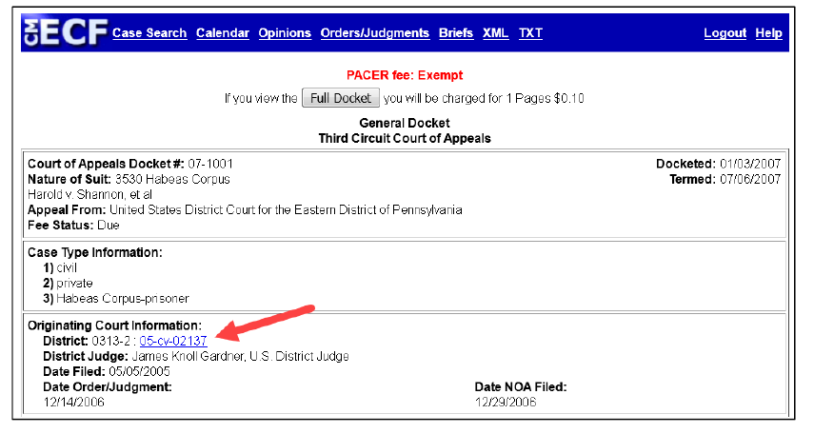
Navigating from a NextGen Court to a CurrentGen Court
The National Court Interpreter Database: A Key to Success
CJA exempt status will not transfer between NextGen and CurrentGen courts.
Exempt status will NOT transfer.
When case link is clicked,
NextGen court = no prefix
CurrentGen court = “x-” prefix with upgraded PACER account user name
Notes:
The CJA exempt status will not transfer between NextGen and CurrentGen courts. For example, if a CJA attorney is logged into an appellate NextGen court with CJA exempt status and then clicks an originating case number link on a docket report for a case in a CurrentGen court, the exempt status will not transfer when you are redirected to the CurrentGen court’s CM/ECF system.
CJA attorneys that are logged into a NextGen CM/ECF court and need to access a CurrentGen court must log off and login again using the “x-” prefix with their upgraded PACER account username in order to access the CurrentGen court’s CM/ECF system.

Slide 4
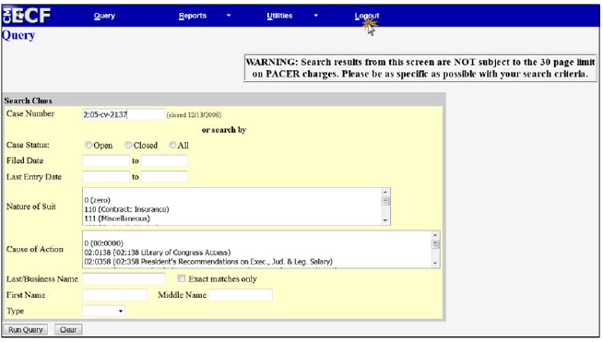
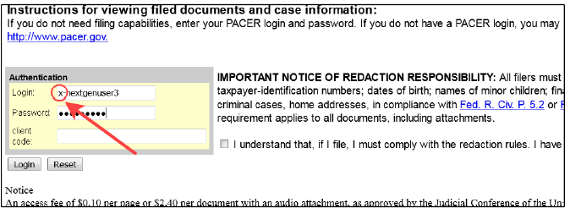
To View CurrentGen Court Docket Sheet
The National Court Interpreter Database: A Key to Success
Click Logout.
CurrentGen Docket Sheet selection criteria.
Click Logout.
Add “x-” to user name.
Click Login.
Notes:
When the docket sheet selection criteria screen of the originating case in the CurrentGen district court displays. Click Logout.
The originating court's PACER login page will display. The CJA attorney should login using their upgraded PACER account; adding the “x-” prefix to their username and click Login.

Slide 5
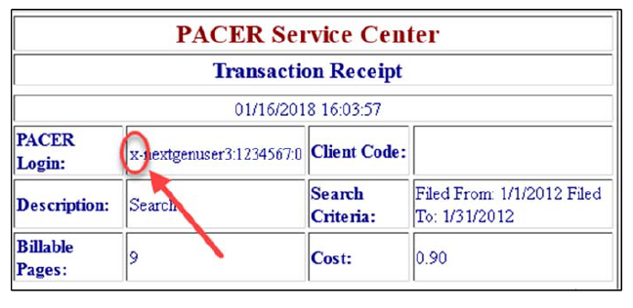
Viewing Exempt Status – CurrentGen Court
The National Court Interpreter Database: A Key to Success
Notes:
The CJA attorney may verify their exempt status by reviewing the receipt.

Slide 6
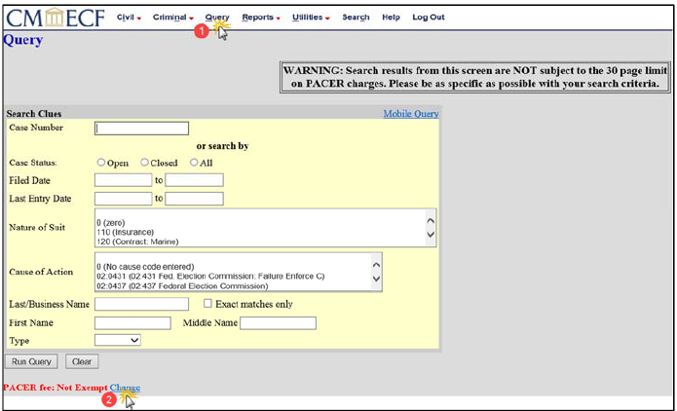
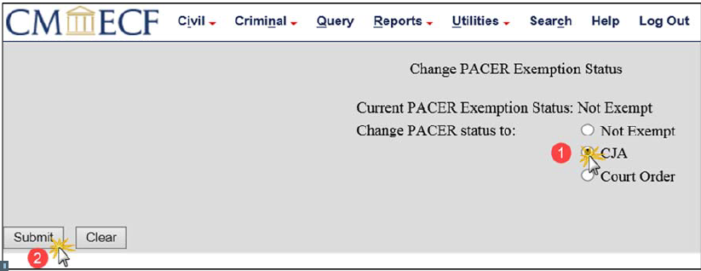
Navigating from a NextGen Court to a NextGen Court
The National Court Interpreter Database: A Key to Success
Changing Exempt Status
Notes:
If a CJA attorney accesses another NextGen court in the same session, the PACER fee status reverts to the default of a “not exempt” status. The exempt status must be changed to “CJA” status, using the Change PACER Exemption Status link when appropriate. There are two ways to change the PACER exempt status.
Click Utilities, then change PACER Exemption Status link.
OR
Click Query, and then Change link. The PACER fee status is located under the Run Query button.
On the Change PACER Exemption Status screen, click CJA radio button. Click Submit. A confirmation screen will display.

Slide 7
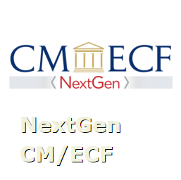
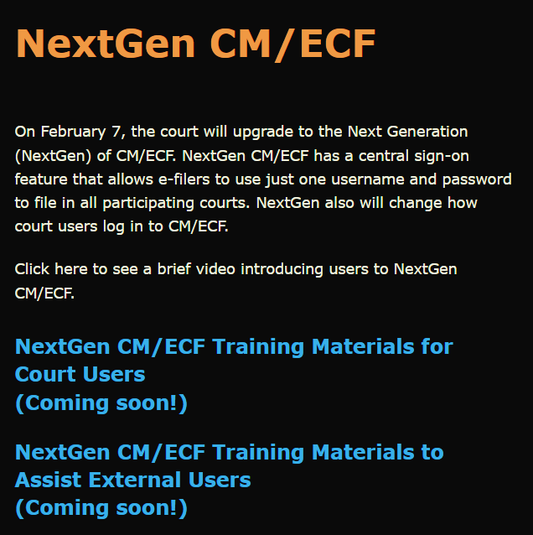
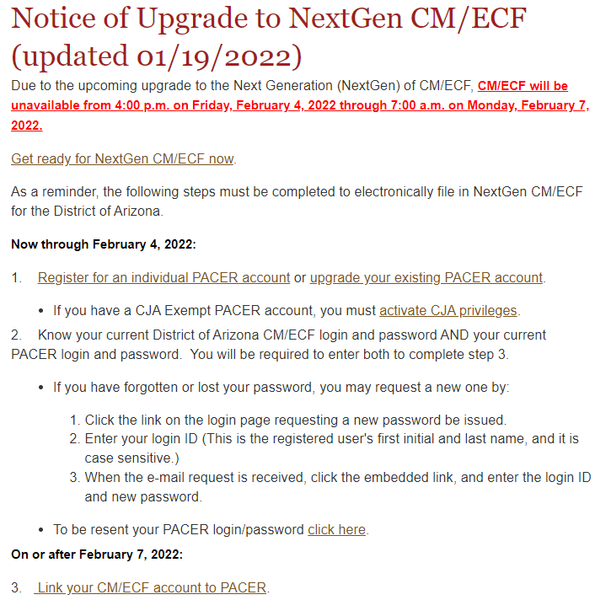
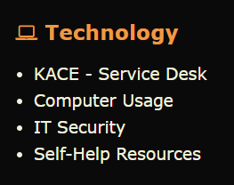
Resources
The National Court Interpreter Database: A Key to Success
District Arizona Intranet Page
District of Arizona internet page: https://www.azd.uscourts.gov
Notes:
This video and other NextGen Resources can be found on the court’s intranet page.
Submit a KACE – Service Desk request for help with NextGen CM/ECF.
Direct the public to the court’s internet page to access NextGen CM/ECF information.

