Slide 1
The National Court Interpreter Database: A Key to Success

Slide 2
NextGen Customer Support
CM/ECF Password Reset
The National Court Interpreter Database: A Key to Success
CM/ECF Account + Upgrade PACER Account
Upgraded PACER Account Single Sign On
On or after February 7, 2022
= Current Gen = NextGen
Notes:
On February 7, 2022, the District of Arizona will upgrade to NextGen CM/ECF. On or after February 7, 2022, e-filers must link their current District of Arizona CM/ECF account to their individual upgraded PACER account. The e-filer must know both their PACER credentials and their District of Arizona CM/ECF login and password to link their accounts. The court anticipates an increase in calls regarding CM/ECF password reset.

Slide 3
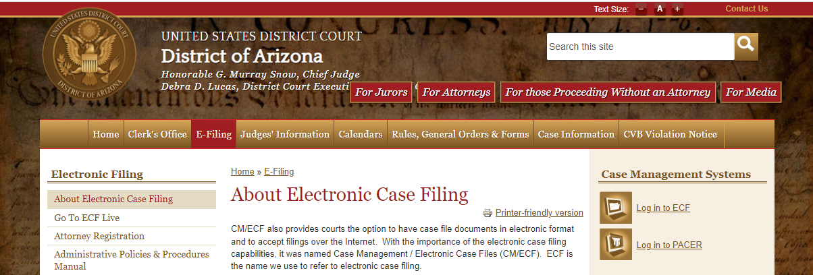
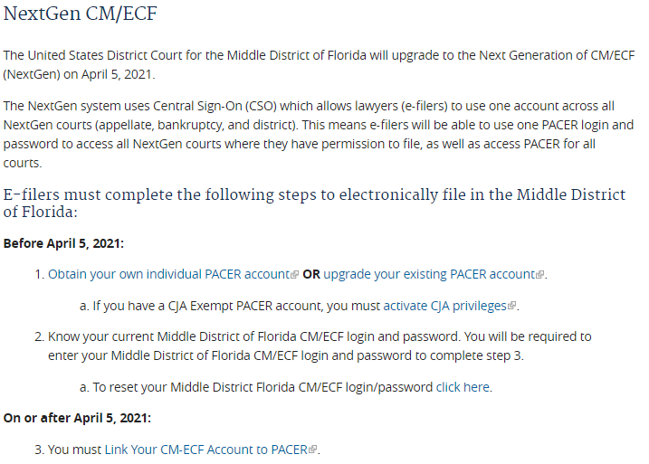
District of Arizona Website.
The National Court Interpreter Database: A Key to Success
The court’s website: www.azd.uscourts.gov
Notes:
**CHANGE ONCE WE UPDATE WEBSITE**
To assist callers with resetting their password for their District of Arizona CM/ECF account, direct them to the court’s website. Assist the caller in navigating to “Reset Your CM/ECF Password.” There are several ways to navigate to the password reset page.
On the homepage, the caller can “Search” for “password reset” in the search field and then select the “Reset Your CM/ECF Password” link.
On the homepage, the caller can click the link to access the NEXTGen Landing page. The caller can click the link to reset their CM/ECF password.

Slide 4
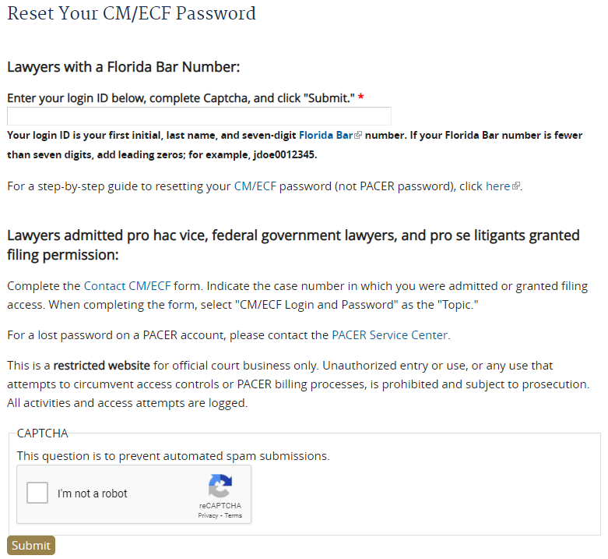
Reset Your CM/ECF Password.
The National Court Interpreter Database: A Key to Success
Notes:
**CHANGE ONCE WE UPDATE WEBSITE**
Callers will be directed to the “Reset Your Password” page.
On the “Reset Your CM/ECF Password” page, attorneys with an Arizona Bar Number can enter their login ID and click Submit. The Login ID for an attorney with an Arizona Bar Number is their first initial, last name, and seven-digit Arizona Bar Number. If the bar number is less than seven digits then add leading zeros. A link will be e-mailed to the registered email address to reset the user’s password. The caller can also find step-by-step instructions by clicking the instructions hyperlink.
Pro hac vice attorneys and pro se litigants granted filing rights must complete and submit the “CM/ECF Contact Form” to reset their CM/ECF password.
The Contact CM/ECF form must also be completed if the attorney is having trouble with their login ID.

Slide 5
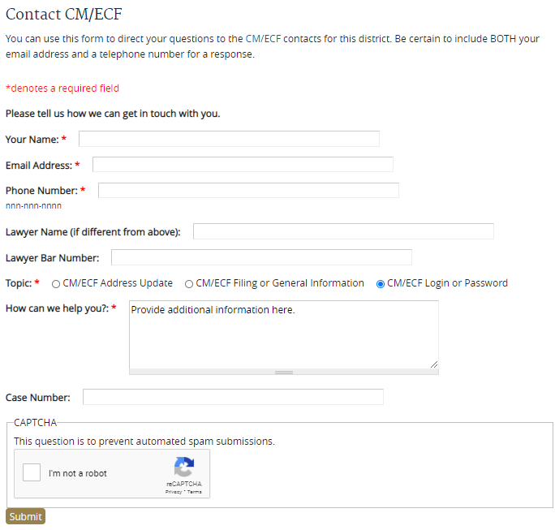
Contact CM/ECF.
The National Court Interpreter Database: A Key to Success
Notes:
**CHANGE ONCE WE UPDATE WEBSITE**
On the Contact CM/ECF form, e-filers requesting a password reset, should complete the form and click the radio button to select “CM/ECF Login and Password” as the “Topic.”
Direct the caller to provide any questions or additional information in the “How can we help you?” text box.
The caller should complete the form in its entirety and then click “Submit.”
An e-mail with CM/ECF credentials will be sent to the registered e-mail address.

Slide 6
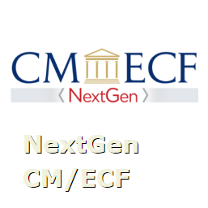
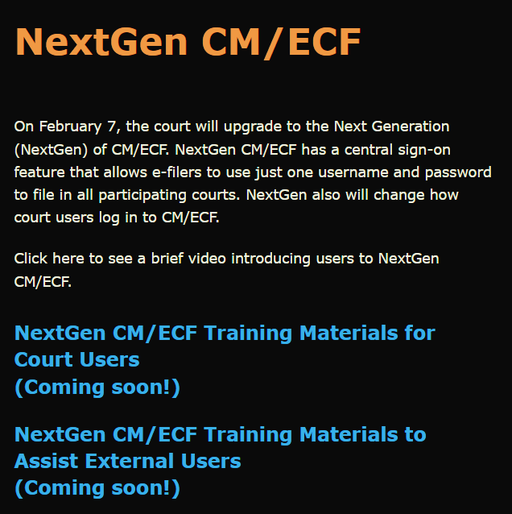
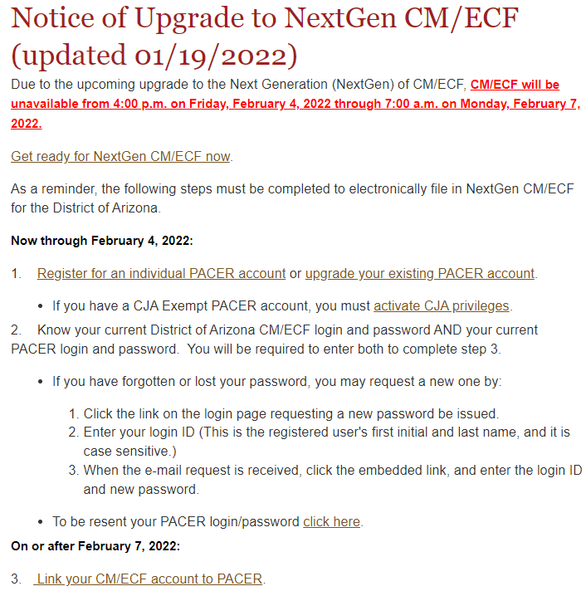
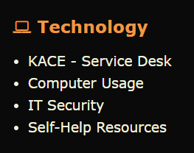
Resources
The National Court Interpreter Database: A Key to Success
District Arizona Intranet Page
District of Arizona internet page: https://www.azd.uscourts.gov
Notes:
This video and other NextGen Resources can be found on the court’s intranet page.
Submit a KACE – Service Desk request for help with NextGen CM/ECF.
Direct the public to the court’s internet page to access NextGen CM/ECF information.

