Slide 1
The National Court Interpreter Database: A Key to Success

Slide 2
Link Your CM/ECF Account to PACER
The National Court Interpreter Database: A Key to Success
CM/ECF Account + Upgrade PACER Account
Lawyers, Contracted Court Reports, Pro Se Litigants
Upgraded PACER Account Single Sign On
= Current Gen = NextGen
Linking is a one-time process and can only be completed on or after February 7, 2022.
**User must know their login and password for MDFL CM/ECF and PACER.**
Notes:
On February 7, 2022, the District of Arizona will upgrade to NextGen CM/ECF. All external CM/ECF filers must link their current CM/ECF account to their upgraded PACER account. External users include lawyers, contracted court reporters, and pro se litigants that have been granted CM/ECF filing access. In preparation for NextGen and Single Sign On, , PACER accounts were updated to individual accounts and are referred to as Upgraded PACER accounts.
Linking is a one-time process and can only be completed on or after February 7, 2022. When assisting callers with linking their accounts, you must confirm that the e-filer has an individual and upgraded PACER account and confirm that they know their login and password for both the District of Arizona CM/ECF and PACER.

Slide 3
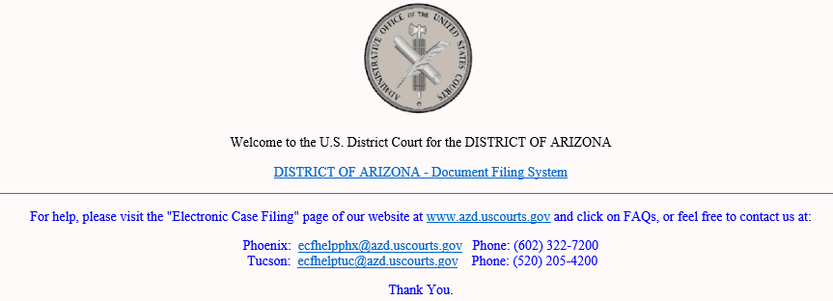
Linking a CM/ECF Account to a PACER Account
The National Court Interpreter Database: A Key to Success
Go to the Court’s CM/ECF site: https://ecf.azd.uscourts.gov
Notes:
To begin the linking process the e-filer must go to the District of Arizona’s CM/ECF website. You can help callers access CM/ECF through the court’s internet page or by entering the url web address in their browser. Once the e-filer is on the CM/ECF landing page, they click the link for the “DISTRICT OF ARIZONA – Document Filing System.”

Slide 4
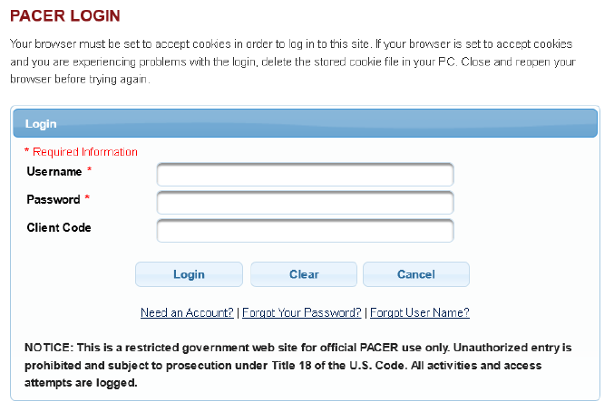
PACER Login
The National Court Interpreter Database: A Key to Success
Do not login with a shared firm PACER account.
Notes:
The e-filer will be taken to the PACER login screen. The e-filer must login with their individual PACER credentials and then click the “Login” button. It is important to remind e-filers that they can not login with a shared PACER account.

Slide 5
Utilities Menu
The National Court Interpreter Database: A Key to Success
Notes:
Once the e-filer is logged in, direct them to select the “Utilities” menu and then select “Link a CM/ECF account to my PACER account.”
Notice that the “Civil” and “Criminal” CM/ECF menu items are not displayed.

Slide 6
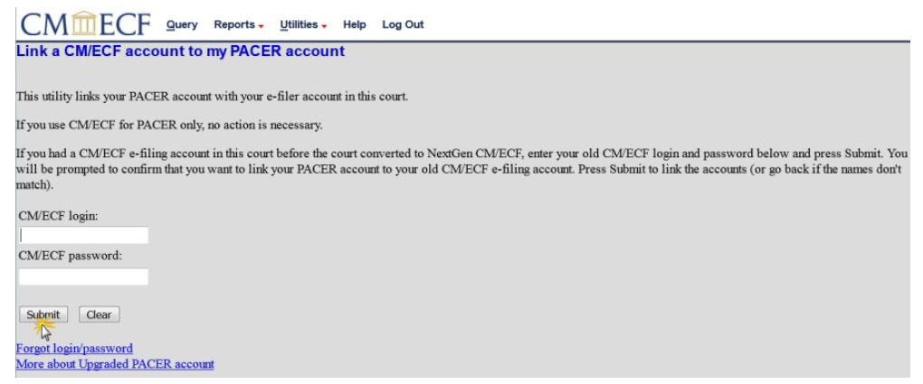
The National Court Interpreter Database: A Key to Success
Link a CM/ECF Account to my PACER Account
Notes:
On the utility screen the e-filer enters their CM/ECF login and password for the District of Arizona and clicks “Submit.”

Slide 7
Linking Confirmation
The National Court Interpreter Database: A Key to Success
NOTE: Make sure you are linking to your individual PACER account.
Notes:
The e-filer will verify that the CM/ECF account and PACER account listed are accurate and if so, click “Submit.” It is important to remind e-filers not to link to a shared firm account.

Slide 8
Refresh Screen
The National Court Interpreter Database: A Key to Success
Press F5
Notes:
The e-filer may need to refresh their browser to see the “Civil” and “Criminal” CM/ECF menu items. Pressing “F5” or “Ctrl + F5” will refresh the browser.

Slide 9
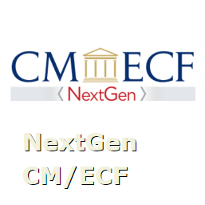
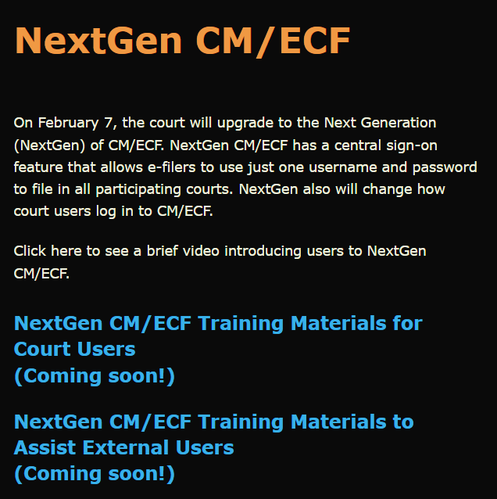
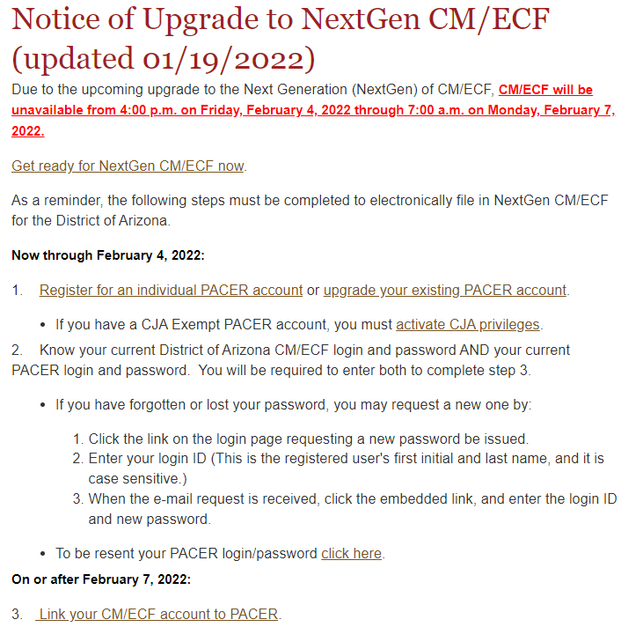
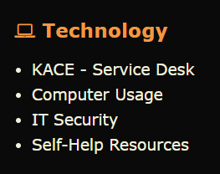
Resources
The National Court Interpreter Database: A Key to Success
District Arizona Intranet Page
District of Arizona internet page: https://www.azd.uscourts.gov
Notes:
This video and other NextGen Resources can be found on the court’s intranet page.
Submit a KACE – Service Desk request for help with NextGen CM/ECF.
Direct the public to the court’s internet page to access NextGen CM/ECF information.

