Slide 1
The National Court Interpreter Database: A Key to Success

Slide 2
The National Court Interpreter Database: A Key to Success
Maintain NextGen
CM/ECF Account
E-filers will log into PACER to update contact information.
Notes:
On February 7, 2022, the District of Arizona will upgrade to NextGen CM/ECF. Once the upgrade takes place all NextGen CM/ECF account maintenance is updated and maintained through PACER. It is the e-filers’s responsibility to keep their contact information updated for compliance with local rules and proper receipt of Notices of Electronic Filing.
E-filers will make updates to their name, mailing address, and e-mail addresses by logging into PACER.

Slide 3
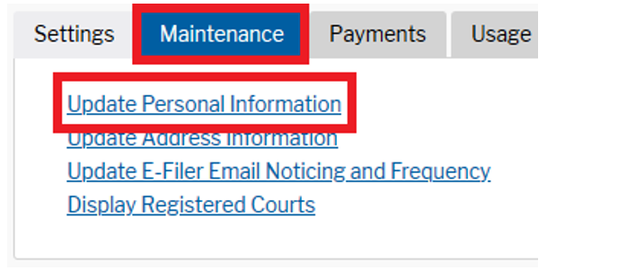
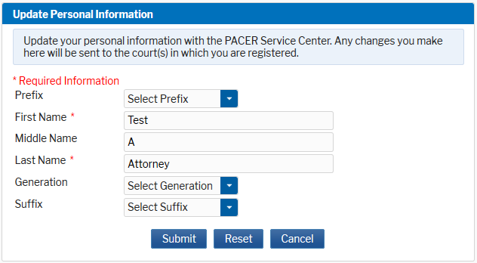
Name Change
The National Court Interpreter Database: A Key to Success
Notes:
Let’s start with name changes. After logging into PACER, the e-filer will select the “Maintenance” tab and click “Update Personal Information.”
The e-filer will be able to update the first, middle, and last name. Please note that the first and last name are required fields. The e-filer will also be able to add a Generation and Suffix. Once the updates are made, the e-filer clicks Submit.
They will then receive a confirmation screen.

Slide 4
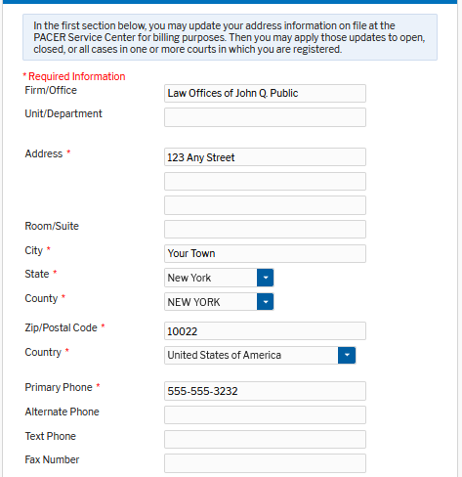
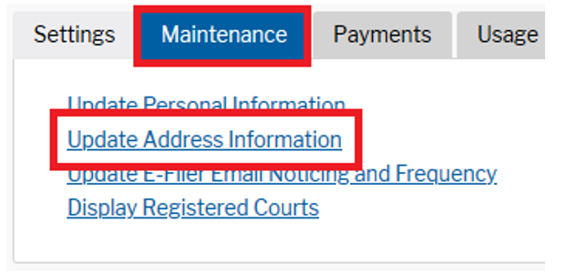
Update Your Mailing Address
The National Court Interpreter Database: A Key to Success
Notes:
Next, lets review how e-filers will update their mailing address.
Under the “Maintenance” tab select “Update Address Information” to update a mailing address.
The e-filer will enter their updated contact information. This is the address that displays on the court’s docket.

Slide 5
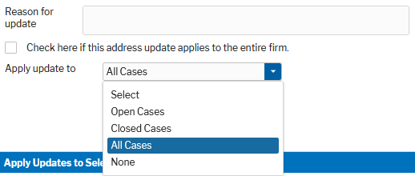
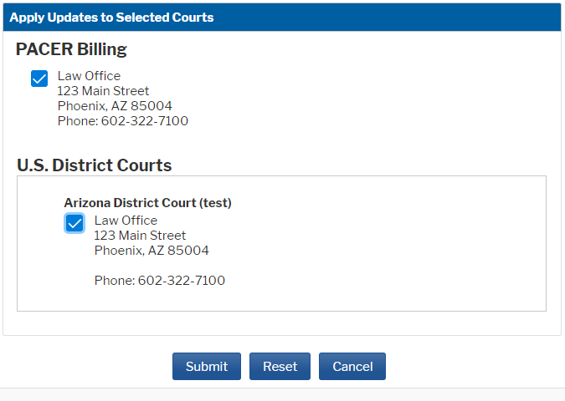
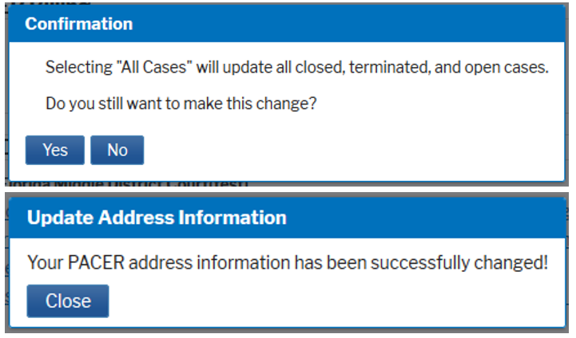
Apply Mailing Address Updates
The National Court Interpreter Database: A Key to Success
Notes:
Next, the e-filer will enter the “Reason for the Update.”
The e-filer must select how to apply the update by selecting an option from the “Apply Update To” drop-down menu. Highlight the option to select. It is recommended that changes are applied to “All Cases.” The court does make the final determination regarding which cases(s) an address update is applied to.
At the bottom of the “Update Address Information” screen, the e-filer can select to update their PACER billing address and select the courts in which the changes apply. Multiple courts may be listed. Click the box to mark the selected options and then click Submit.
A Confirmation screen will display. Confirmation screens vary based on the selections made.

Slide 6
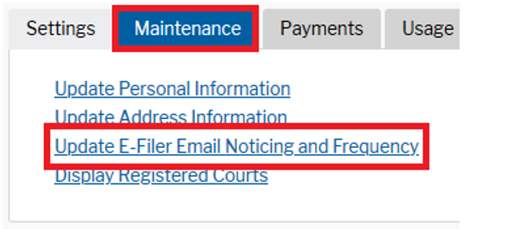
Update Primary Email Address
The National Court Interpreter Database: A Key to Success
Notes:
E-filers must keep their primary e-mail address updated to be in compliance with Local Rules and to receive Notice of Electronic Filing. The primary e-mail address displays on the court’s docket.
The Primary e-mail address is updated under the “Maintenance” tab by selecting “Update E-Filer Email Noticing and Frequency.”

Slide 7
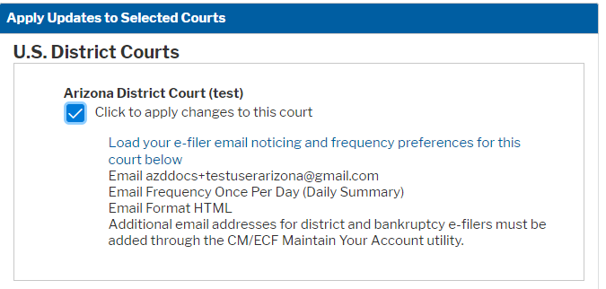
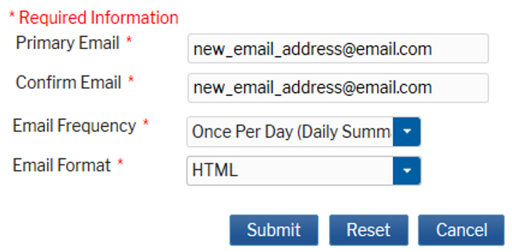
Apply Email Address Updates
The National Court Interpreter Database: A Key to Success
Notes:
The e-filer will be able to select the courts in which they want to apply the e-mail update. Multiple courts may be listed. Click the box to mark the selected courts.
The e-filer will enter their new primary e-mail address, select the frequency option from the drop-down menu, and select the format option from the drop-down menu. HTML format is recommended.
Once the update is entered, click Submit. The update is sent to the court for processing and a confirmation screen displays.
Please note that if the e-filer wants their noticing frequency and/or format to vary from court to court, they must update each court individually.

Slide 8
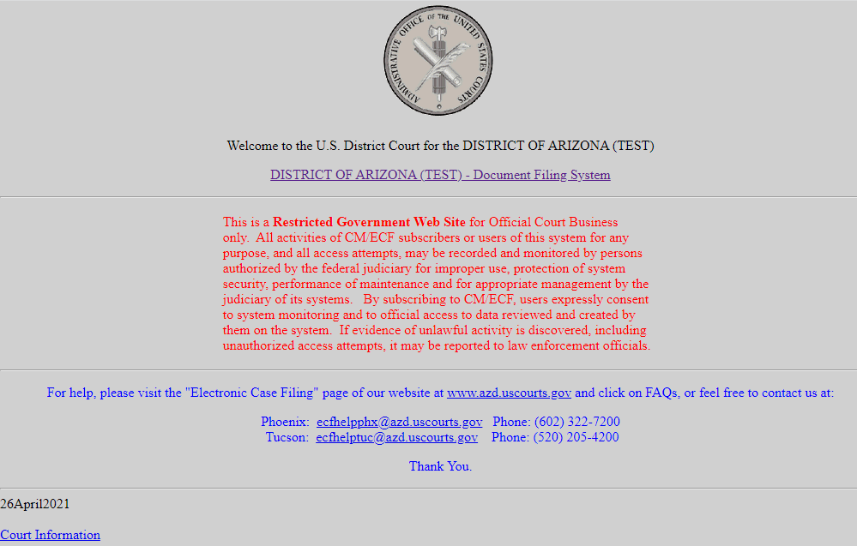
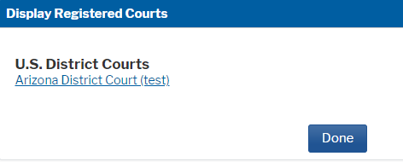
Update Secondary Email Address
The National Court Interpreter Database: A Key to Success
Notes:
E-filers may add secondary e-mail addresses to their CM/ECF account. Secondary e-mail addresses will also receive the Notice of Electronic Filing.
From the “Maintenance” tab select “Display Registered Courts.”
On the “Display Registered Courts” screen, select the hyperlink for the “Florida Middle District Court.” From the CM/ECF landing page, select the “Middle District of Florida – Document Filing Link.”

Slide 9
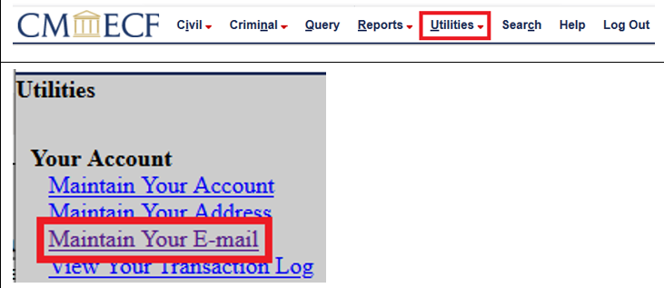
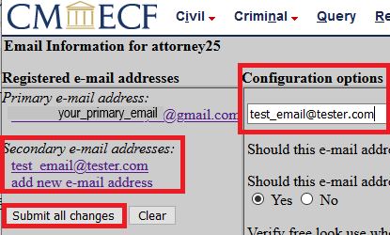
Update Secondary Email Address
The National Court Interpreter Database: A Key to Success
Notes:
The e-filer must then select the CM/ECF “Utilities” menu and then the “Maintain Your E-mail” hyperlink.
On the Email Information screen, the e-filer can add, edit, or delete a Secondary E-mail Addresses by clicking the e-mail hyperlink. Enter, edit, or remove the e-mail address under the “Configuration Options.” The e-filer can edit the configuration options for each secondary e-mail address. The default settings can remain.
Once the changes are complete, click “Submit All Changes”

Slide 10
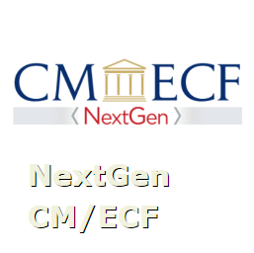
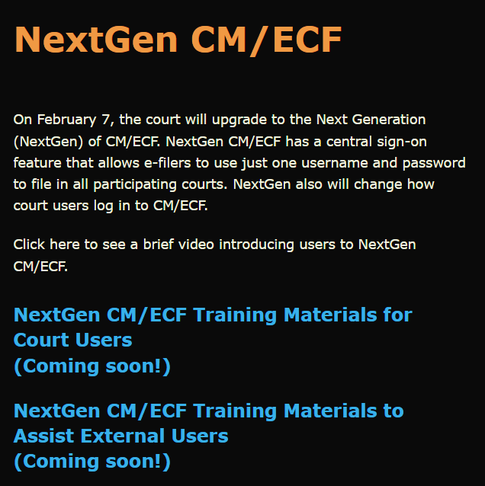
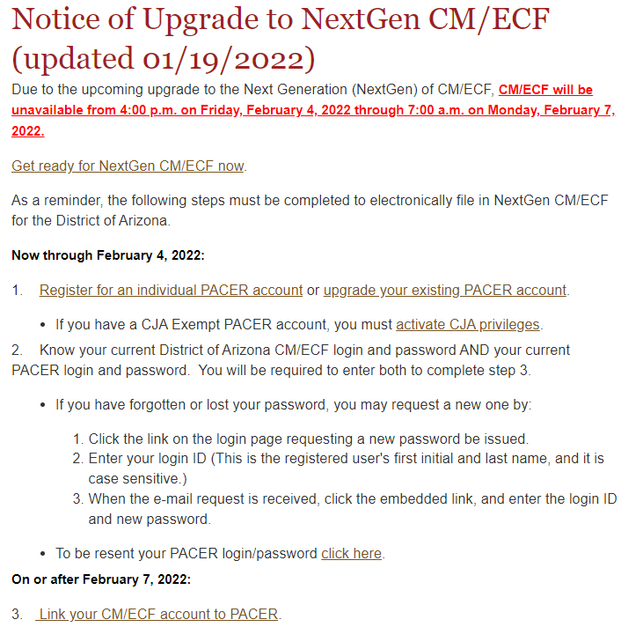
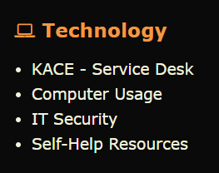
Resources
The National Court Interpreter Database: A Key to Success
District Arizona Intranet Page
District of Arizona internet page: https://www.azd.uscourts.gov
Notes:
This video and other NextGen Resources can be found on the court’s intranet page.
Submit a KACE – Service Desk request for help with NextGen CM/ECF.
Direct the public to the court’s internet page to access NextGen CM/ECF information.

