Slide 1
Nuts & Bolts of Federal Practice
Benjamin L. Rundall, Esq. (Civil Rights Attorney)
Zwillinger Wulkan PLC

Slide 2
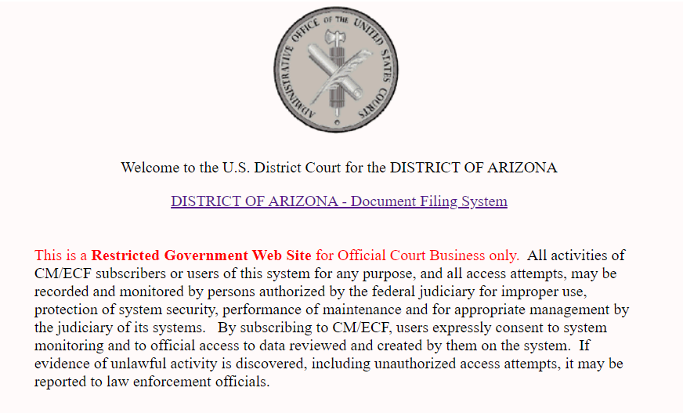
You’ve been appointed! What now?
Notes:
So, you’ve been appointed to a case through the Court’s civil litigation panel. Congrats! But where do you start?
The first place to start is ECF/Pacer. ECF stands for Electronic Court Filing. Recently it has been combined with PACER. ECF is not only how you will file documents with the Court, but it can also help you find all of the information you need about a case you’ve been assigned.

Slide 3
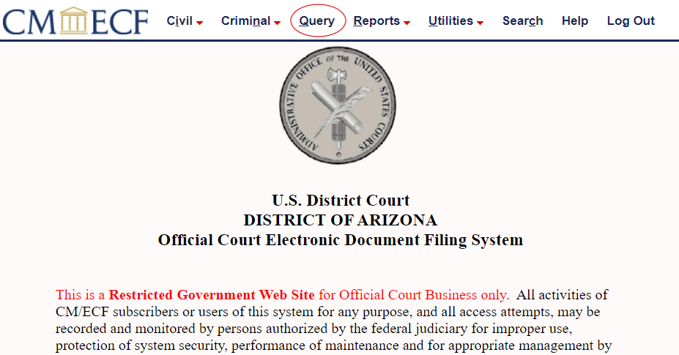
Finding Cases with ECF/PACER – Step 1

Slide 4
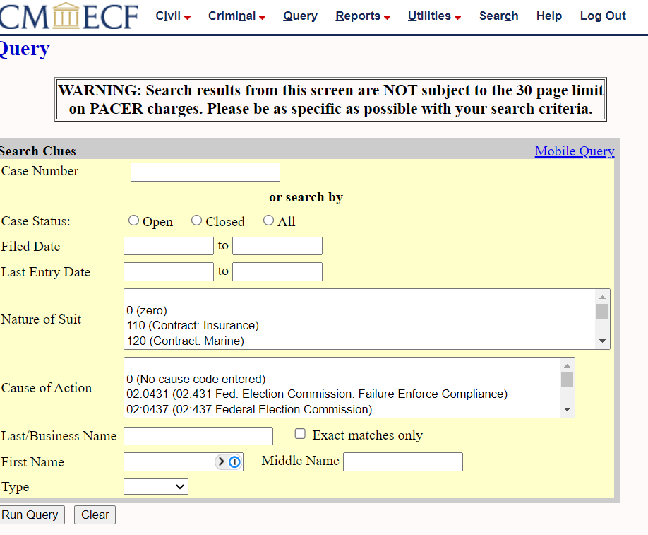
Finding Cases with ECF/Pacer – Step 2

Slide 5
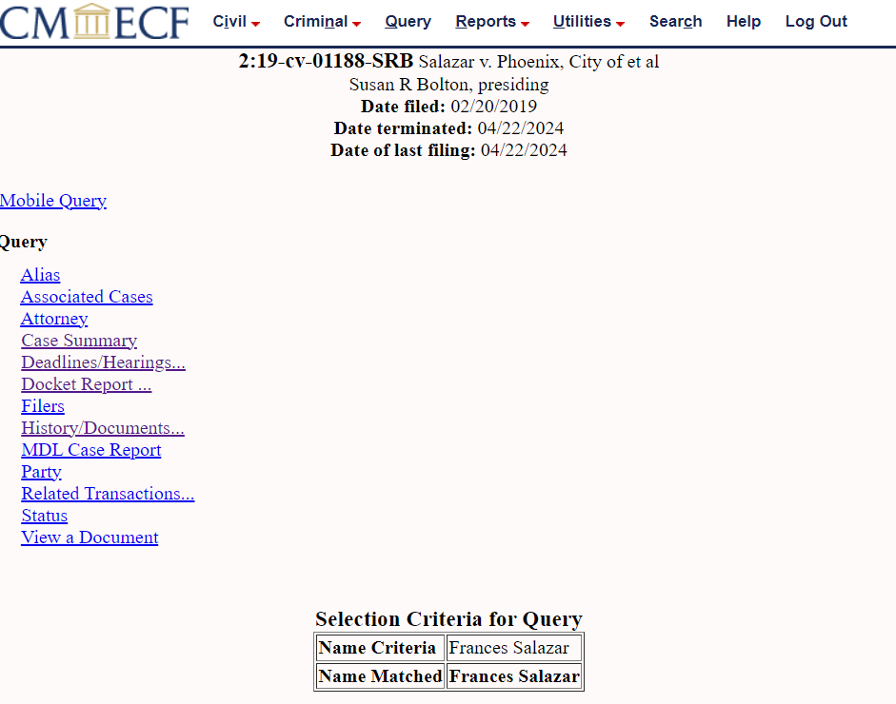
Finding Cases with ECF/Pacer – Step 3

Slide 6
What Documents Should you Look For First?
Complaint/Amended Complaint
Case Management Order/Rule 26 Joint Report
Dispositive Motions
Motion to Dismiss
Motions for Summary Judgments
Orders from the Court
On Dispositve Motions
Discovery Disputes
Contempt/Sanctions

Slide 7
Once you have reviewed and pulled documents from ECF/Pacer, consider the following:
Are there any upcoming deadlines that you need to be aware of for your client?
Are there any outstanding requests from the Court to the parties about things that need to be done?
E.g., Meet and Confer, Exchange Certain Discovery
What is the next thing you need to prepare for?

Slide 8
Phases of a Civil Case
Complaint
Motion to Dismiss
Discovery
Motions for Summary Judgment
Pre-trial
Trial
Notes:
Determine which phase you are in so you can plan accordingly.

Slide 9
Talk to the Client
Once you have some initial information and have determined what phase you are in, call the client and talk to them about their case. You may want to ask for:
Any Disclosure Statements they have sent or received in the case;
And Written Discoveyr they have sent or received in the case;
Any documents/evidence/witnesses that they think are important for their case that have not been disclosed.

Slide 10
Contact Opposing Counsel
Sometimes after talking to your client you will learn they do not have certain discovery items that were sent to them by the other side.
If that happens, contact opposing counsel and simply ask them if they will send them to you.
Check with opposing counsel to make sure your analysis of upcoming deadlines mirrors the deadlines they have calendared.

Slide 11
The (Other) Rules of Civil Procedure
Notes:
Make sure to adhere to the Local Rules. Amended Complaints Example.

Slide 12
Judge’s Orders, Forms & Procedures
Notes:
The Court has standard forms used by all judges. But there are also forms unique to each Court that you need to be aware of use when filing motions.

Slide 13
Know your Claims
After talking with your client and reviewing the Complaint, you should make sure you understand the elements of your clients’ claims.
The Ninth Circuit offers Model Civil Jury Instructions which is a comprehensive (though non-exhaustive) list of the elements required to prove most civil claims in Federal Court
(https://www.azd.uscourts.gov/judges/judges-orders)
For Civil Rights Claims, the Ninth Circuit also offers a handbook for most 1983 claims (https://www.ca9.uscourts.gov/guides/section-1983-outline/)

Slide 14
Practice Pointers – Court Appearances
Always stand when addressing the bench
Stop speaking when the Court starts talking
If asked a direct question by the Court, give a direct answer (Yes, because…/No, because…)
Make sure any evidence you want the Court to see has been included in your motion prior to argument and labeled/BATES to make it easier to reference
Ask to reserve time for rebuttal if you would like rebuttal time.

Slide 15
Practice Pointers – Pretrial Work
Motions in Limine
Joint Pre-Trial Statement
Witnesses for trial
All documents for trial
Jury Instructions
Trial Subpoenas
Usually, you have to work with the other party
Give yourself at least a month in advance of trial to work on these issues.
Notes:
Don’t Procrastinate! Joint Pre-Trial Reports require the parties to provide all information that will be used during trial. You will need to consult with your client and consider:

Slide 16
Costs – General Order 10-10

Slide 17
Questions?
Benjamin L. Rundall, Zwillinger Wulkan, PLC
Ben.Rundall@zwfirm.com

