Slide 1
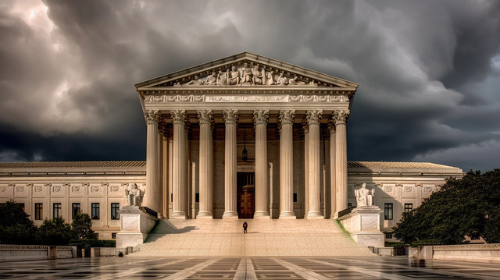

Civil Litigation Panel Training
United States District Court · District of Arizona
Federal Bar Association · Phoenix & Tucson Chapters
Step Up to Justice
June 6, 2024 Phoenix
June 18, 2024 Tucson

Slide 2
Agenda
11:30 - 12:00 PM |
Ethics
William Furnish,
Osborn Maledon, P.A.
9:00 - 9:10AM |
Welcome
Honorable Michael Liburdi,
U.S. District Court Judge and
Self-Represented Litigants
(SRL) Committee Member
12:00 - 12:45 PM |
Lunch Break
12:45 – 1:15 PM |
Lunch and Positive Experiences
Joshua W. Carden,
Carden Livesay, Ltd.
9:10 - 9:20AM |
Program Overview
Types of Pro Bono Appointments
Judge Michael Liburdi;
Jodie Brown, Supervisory Staff Attorney,
U.S. District Court; and Patricia Gerrich,
Community Legal Services
1:15 - 2:00 PM |
Employment Law Overview
Ivelisse Bonilla, Awerkamp,
Bonilla & Giles, P.C.
9:20 - 10:00AM |
Prison Operations, Procedure, and Culture
Haley Brown, Deputy General Counsel
Sean Malone, ADCRR Asst. Dir. of Prison Operations
Loresa Purden, ADCRR Legal Access Monitor
2:00 – 2:45 PM |
Civil Rights Law Overview II
Jodie Brown, Supervisory Staff Attorney
U.S. District Court
10:00- 10:45AM |
Civil Rights Law Overview
Jodie Brown, JoLynn Nesset, and Sara
Cummings, Staff Attorneys, U.S. District
Court
2:45 - 3:15 PM |
Practice Pointers Nuts & Bolts
Benjamin L. Rundall, Zwillinger Wulkan
3:15 – 3:30 PM |
Wrap Up - Going Forward
Judge Michael T. Liburdi
10:45 - 11:30AM |
Social Security Overview
Robin Larkin and Sarah Fern
Larkin & Fern, PLLC

Slide 3
2023 Filing
Statistics
̶
Self-Represented Litigants (SRL)
District of Arizona
All Civil Cases Filed: 4,021
Incarcerated
SRL Civil Cases Filed: 1,736
Non-Incarcerated
SRL Civil Cases Filed: 625
SRL Civil Case Filings: 58%

Slide 4



Self-Represented Litigant Committee
Established May 2016
Judges, court staff, law clerks, staff attorneys
Addresses issues related to both incarcerated and non-incarcerated SRL litigation

Slide 5
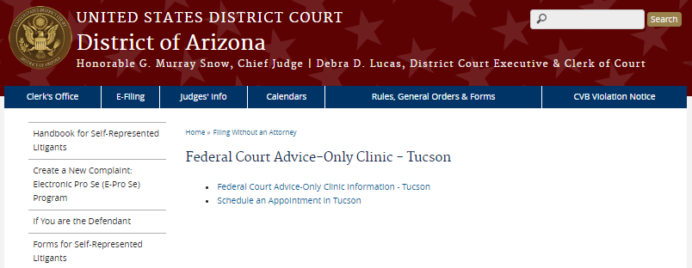
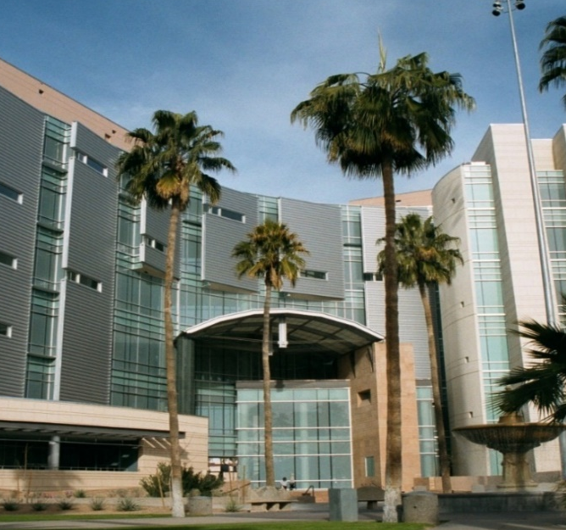
Volunteer Attorney Clinic | Tucson
2023 Statistics
234 Litigants
265 Appointments
26 Volunteers
$75,180
Free Legal Services
Launched in September 2015
Partnership with Step Up to Justice
Appointments Scheduled Online

Slide 6
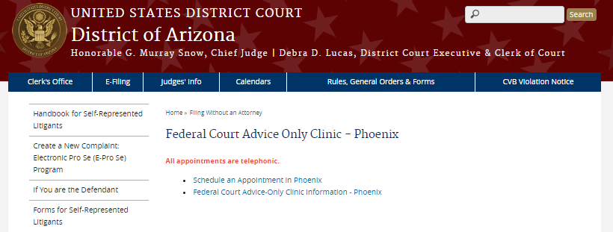
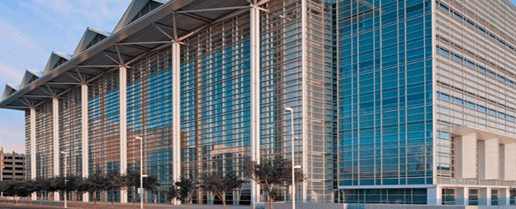
Volunteer Attorney Clinic | Phoenix
2023 Statistics
  170 Appointments
  15 Volunteers
  $35,000 Free Legal Services
Launched in September 2017
Appointments Scheduled Online

Slide 7
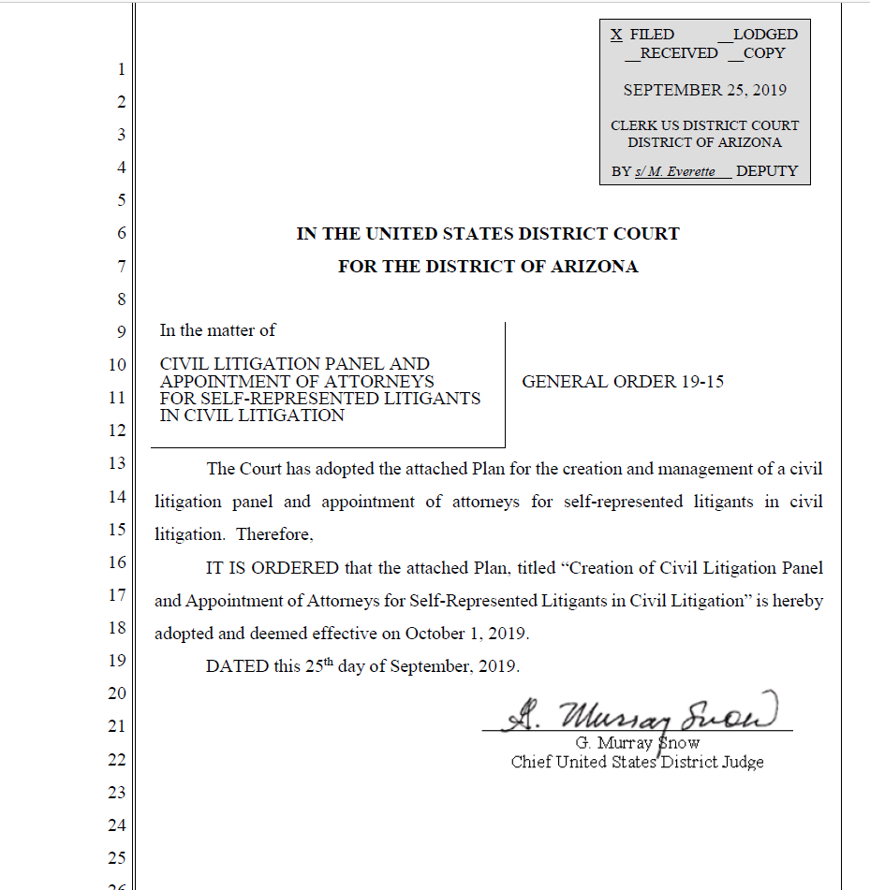


Civil Litigation Panel
General Order 19-15
Appointment of
Attorneys for SRLs
in Civil Litigation

Slide 8
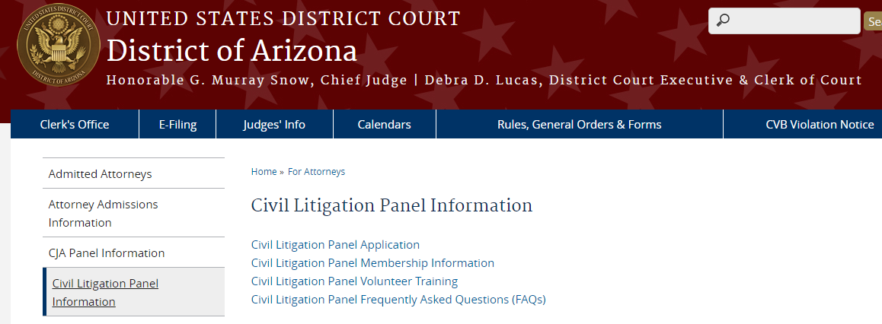
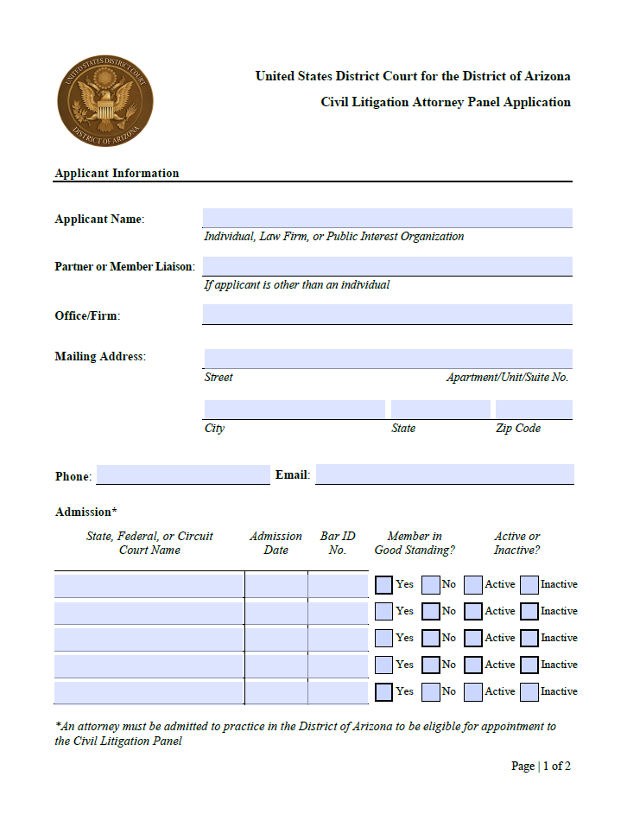
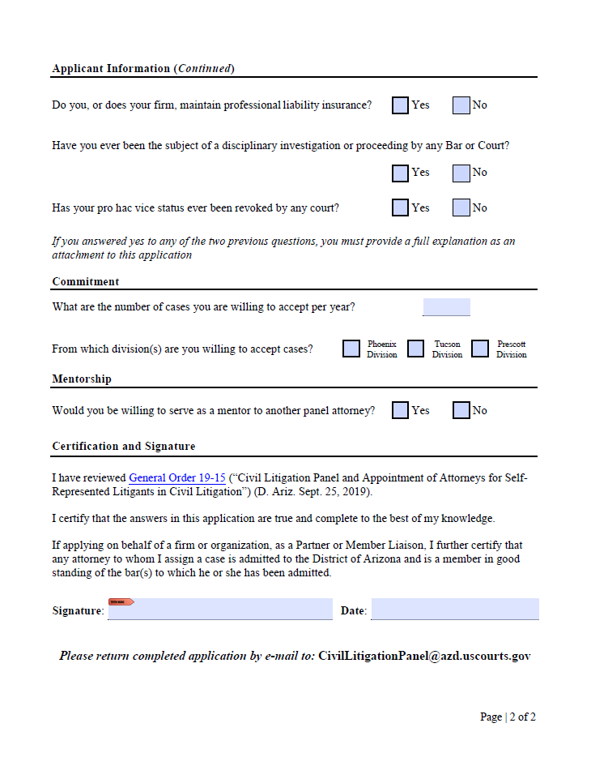

Slide 9
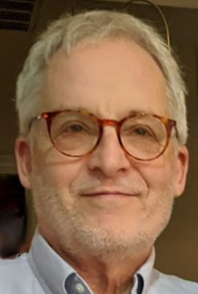
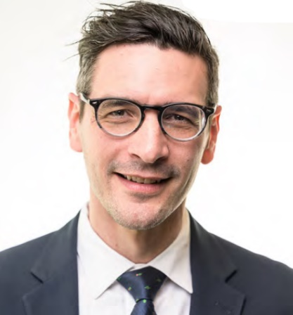
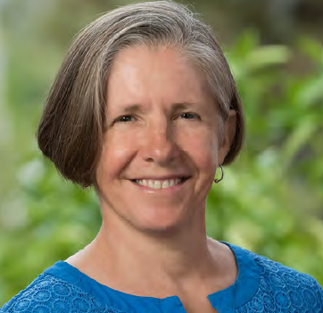
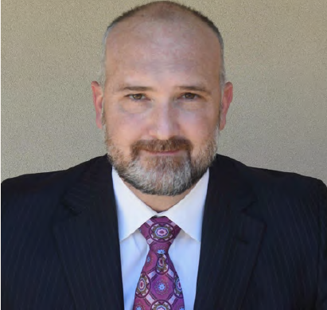
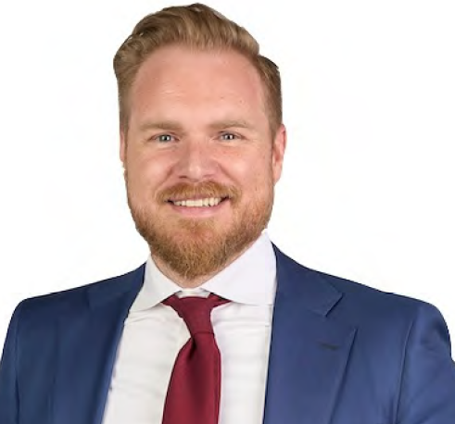
Pro Bono Award Recipients
Andrew Jacob
Jared Keenan
Lisa Anne Smith
Joshua Carden
Benjamin Rundall

