Slide 1
The National Court Interpreter Database: A Key to Success

Slide 2
The National Court Interpreter Database: A Key to Success
Upgrade PACER
Account
Before February 7, 2022
PACER accounts created prior to August of 2014 must be upgraded.
Notes:
On February 7, 2022, the District of Arizona will upgrade to NextGen CM/ECF. All CM/ECF e-filers must have an “upgraded” PACER account.
PACER accounts created prior to August of 2014 must be upgraded. Upgrading a PACER account can take place at any time, however the court recommends that all e-filers upgrade their PACER account before the go-live date on February 7, 2022.

Slide 3
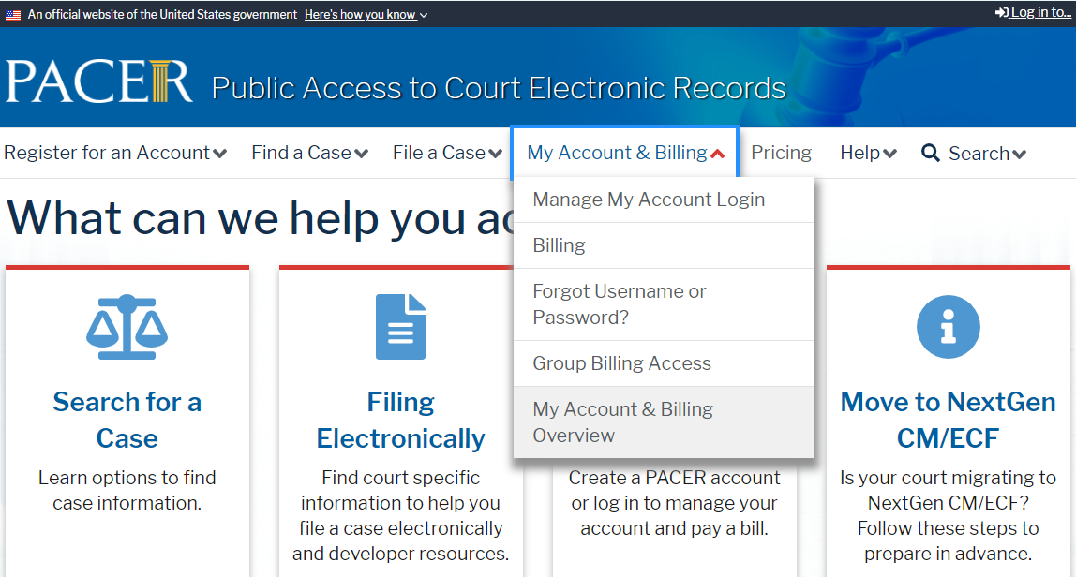
Go to www.pacer.gov
The National Court Interpreter Database: A Key to Success
Notes:
To assist callers with upgrading their PACER account, direct them to go to the PACER website and select “My Account and Billing” and then “Manage My Account Login.”

Slide 4
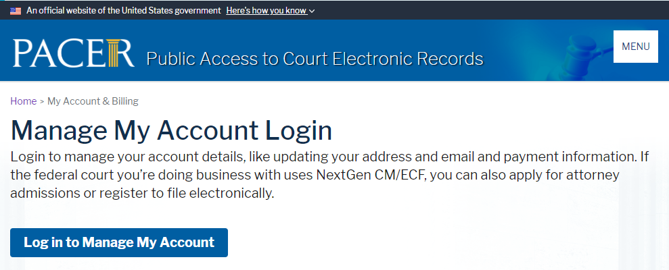
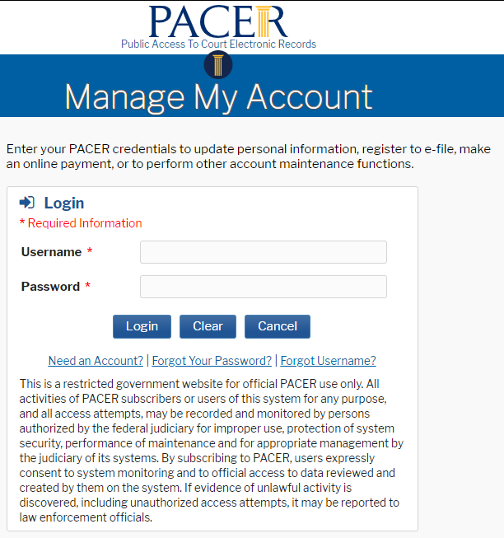
Login to PACER Account
The National Court Interpreter Database: A Key to Success
Notes:
On the Manage My Account Login screen, direct the caller to select “Log in to Manage My Account.” This is where the user will enter their PACER username and password, and then select “Login.”

Slide 5
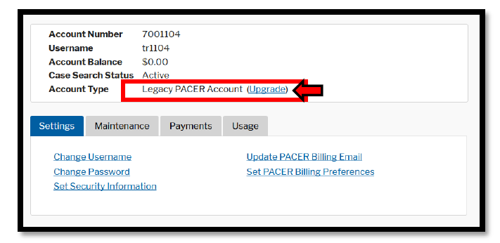
PACER Account Type
The National Court Interpreter Database: A Key to Success
Notes:
The “Manage My Account” screen is where the Account Type can be viewed. “Legacy” account types must be upgraded. Click the “Upgrade” link to upgrade the PACER account.
If the account type is listed as “Upgraded PACER Account” then no action is required.

Slide 6
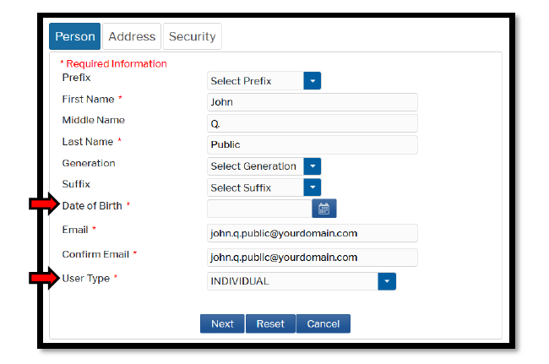
Upgrade PACER Account
The National Court Interpreter Database: A Key to Success
Notes:
Once the “Upgrade” link is selected, the contact information must be verified under the “Person, Address, and Security” tabs.
Under the “Person” tab, verify or update the information listed in the required fields and enter the Date of Birth. Select a “User Type” that best describes the individual associated with this account. A selection of “Individual” or “Attorney” will be the most common choices.
When complete select “Next.”

Slide 7
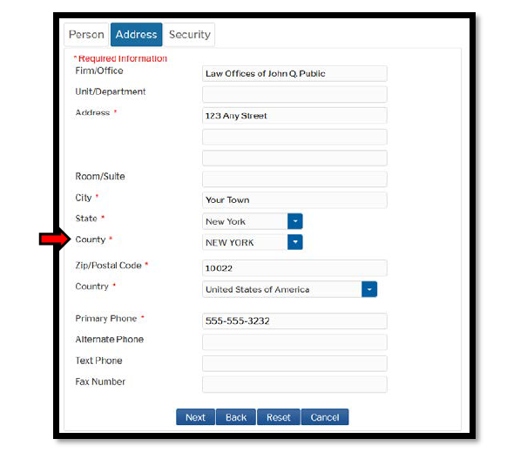
Upgrade PACER Account
The National Court Interpreter Database: A Key to Success
Notes:
Under the “Address” tab, verify or update the information listed in the required fields and select the “County.”
When complete select “Next.”

Slide 8
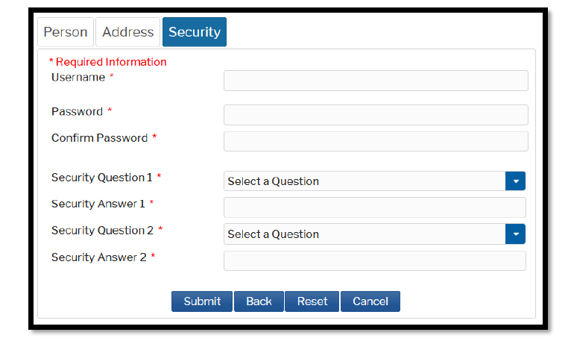
Upgrade PACER Account
The National Court Interpreter Database: A Key to Success
Notes:
Under the “Security” tab create a new username, password, and security questions. Click Submit when complete.
This completes the PACER account upgrade process. The user will no longer be able to use their old PACER credentials.

Slide 9
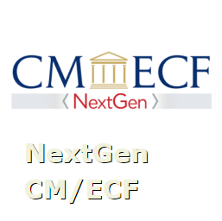
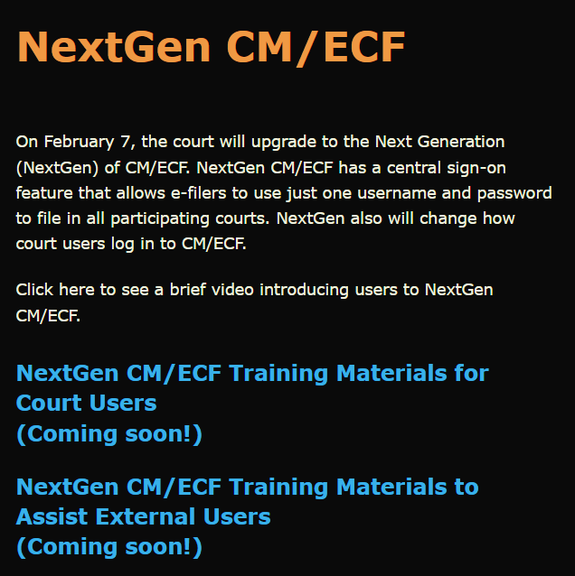
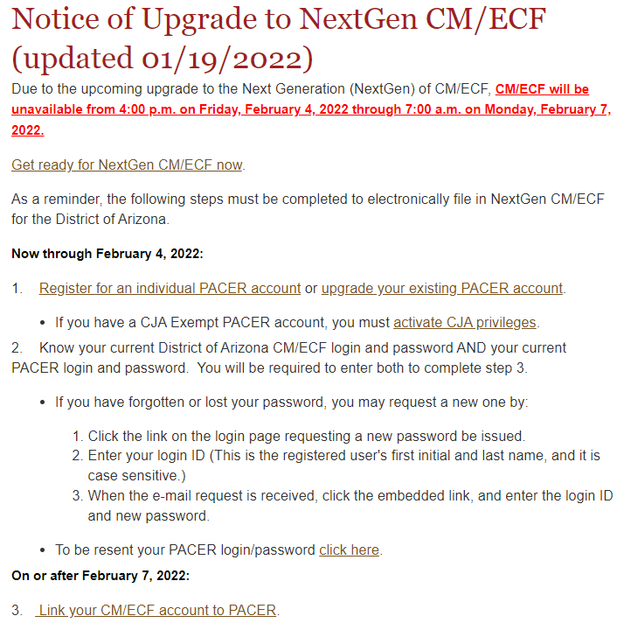
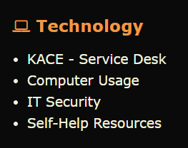
Resources
The National Court Interpreter Database: A Key to Success
District Arizona Intranet Page
District of Arizona internet page: https://www.azd.uscourts.gov
Notes:
This video and other NextGen Resources can be found on the court’s intranet page.
Submit a KACE – Service Desk request for help with NextGen CM/ECF.
Direct the public to the court’s internet page to access NextGen CM/ECF information.

